Slide 1

Celebration of Learning
Mrs. Hinds' Classes
Open House 2022

Slide 2




"A Sticky Situation"
Kindergarten

Slide 3
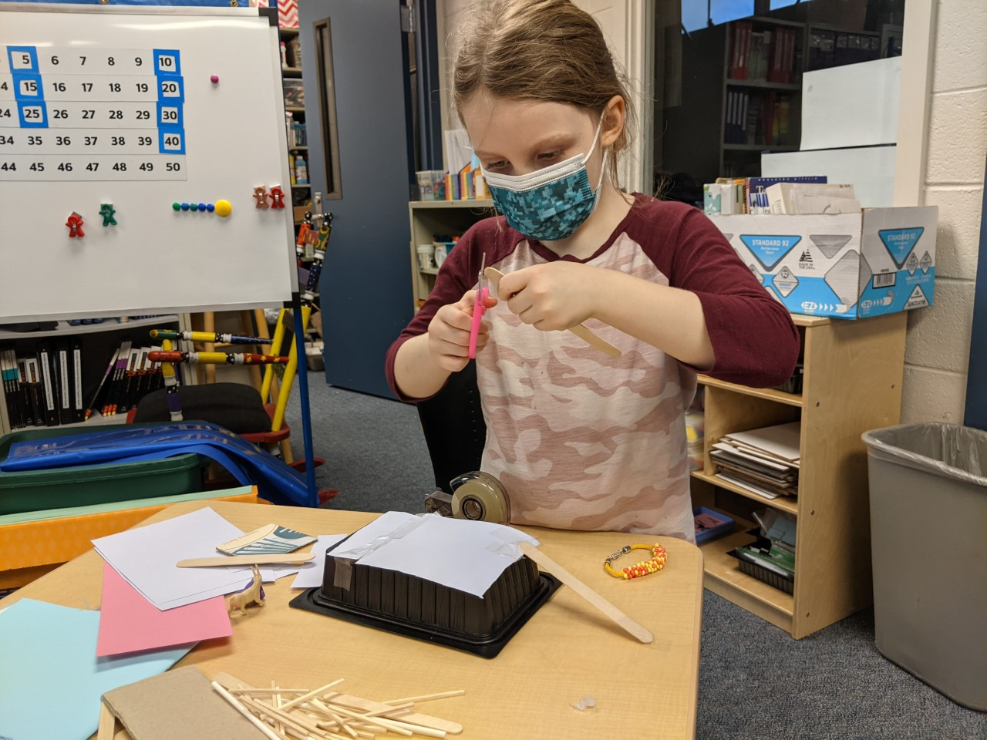
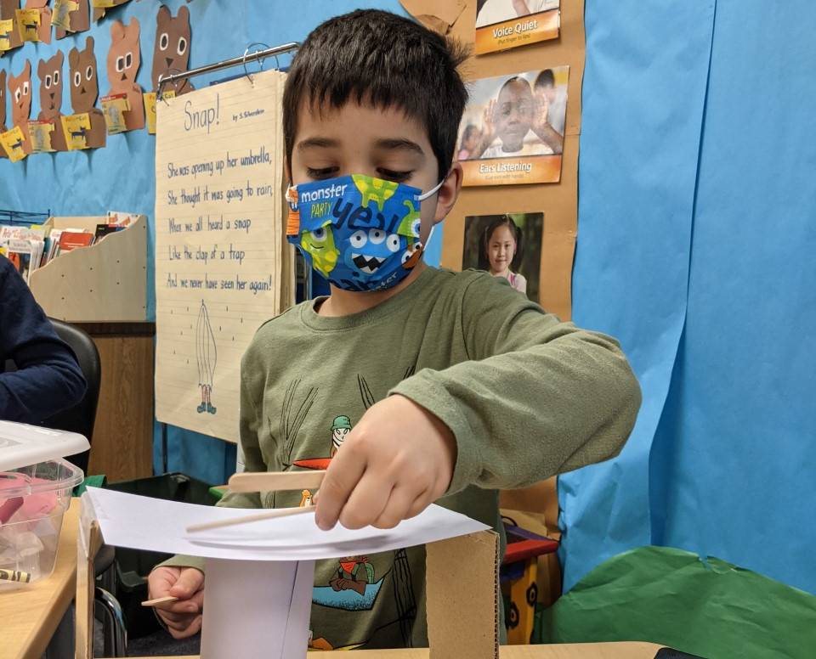
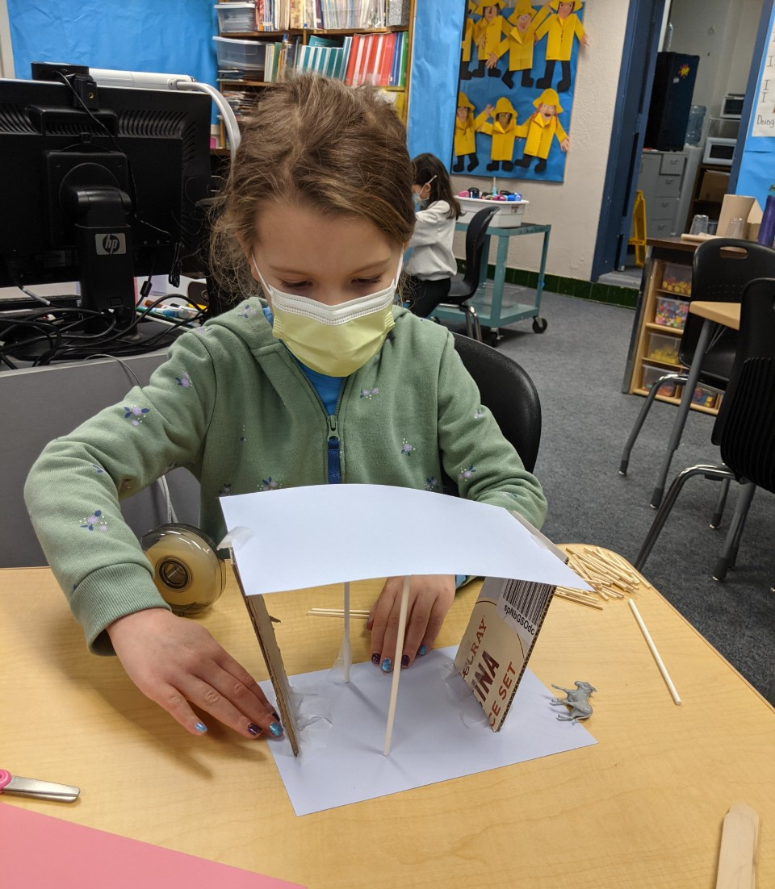
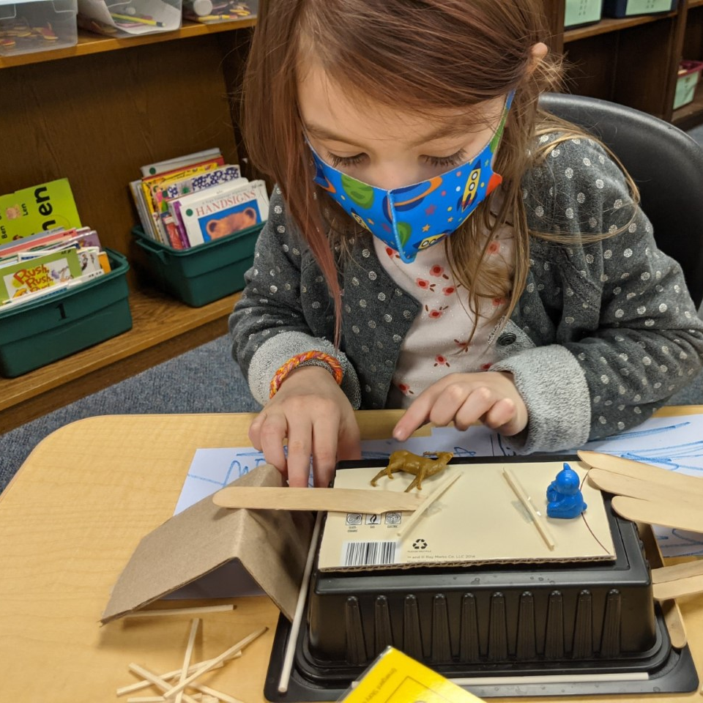
"A Sticky Situation"
Kindergarten
Inspired by the story, Three Billy Goats Gruff, Kindergarten students were presented with a design challenge to create a bridge to safely allow the billy goats to get past the troll!

Slide 4
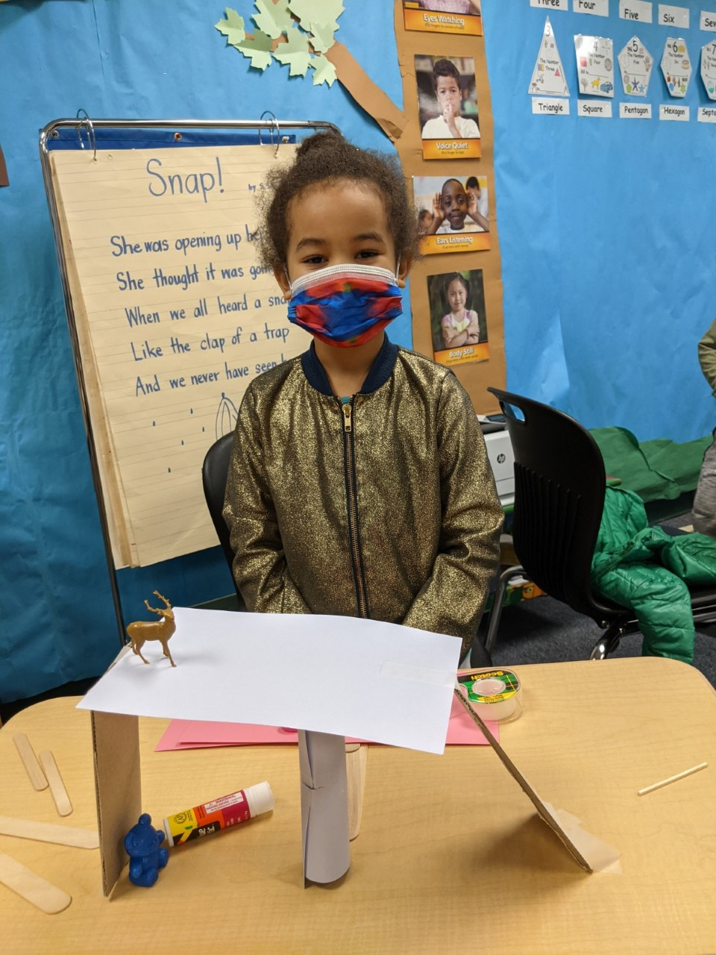
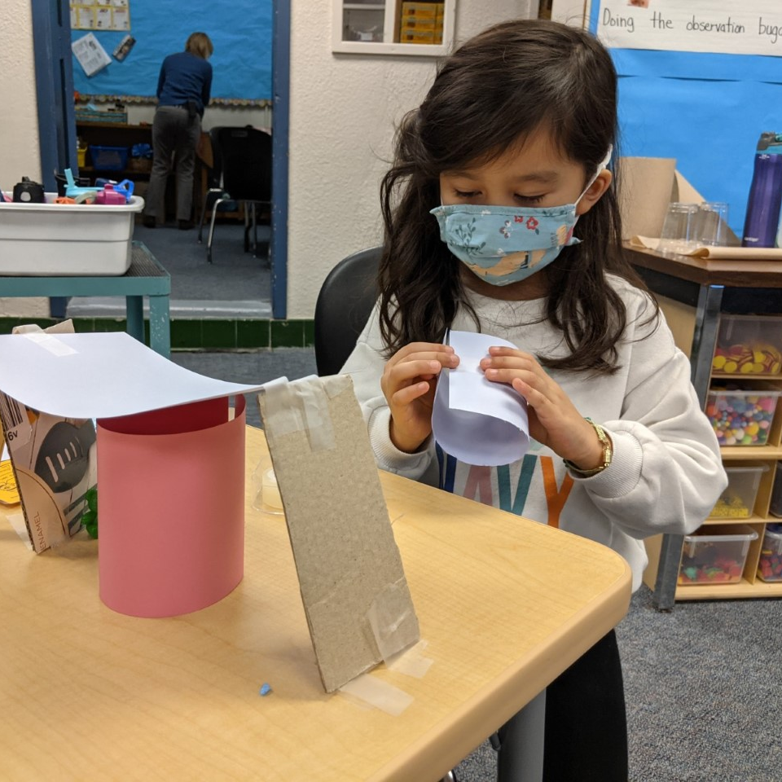
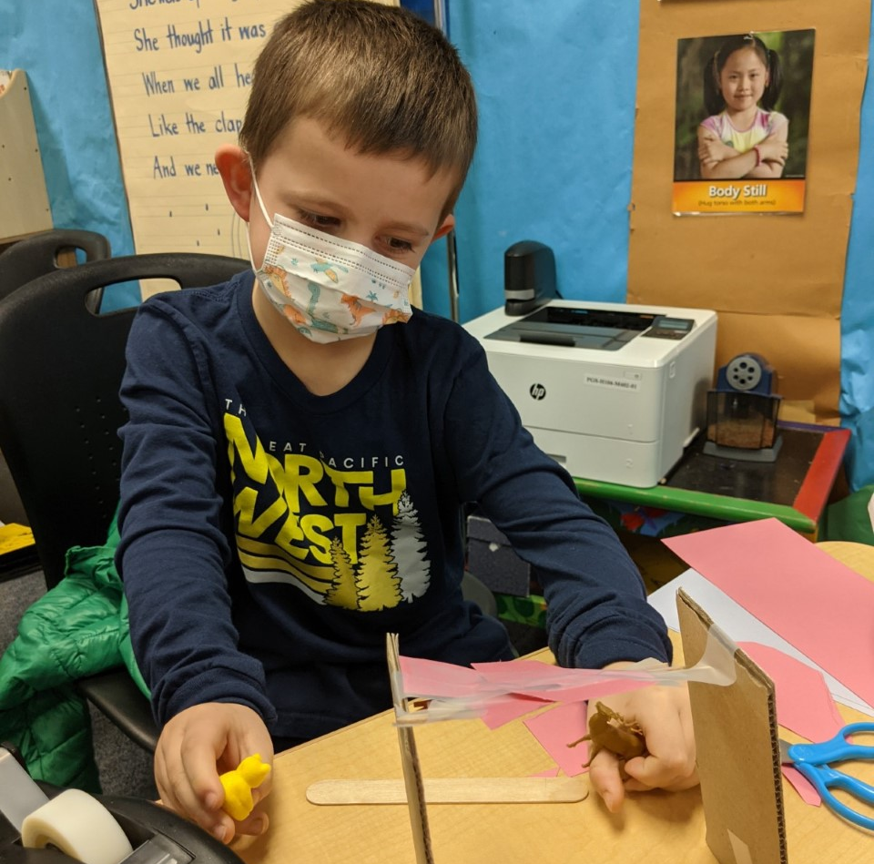
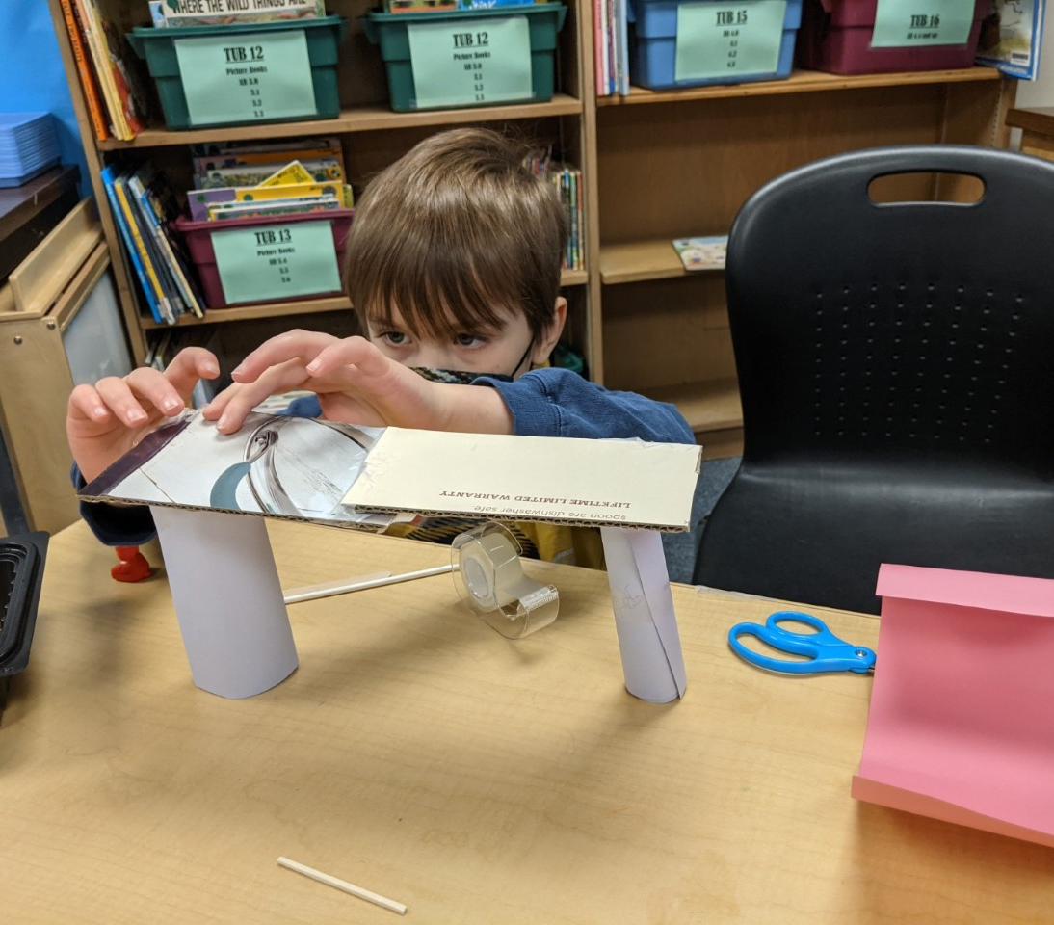
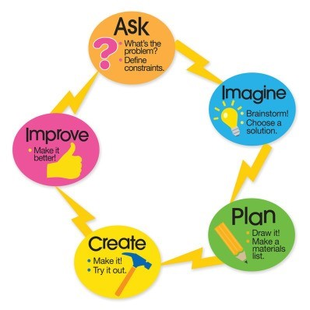
Students work through the Engineering Design Process to create their bridges.
"A Sticky Situation"
Kindergarten

Slide 5
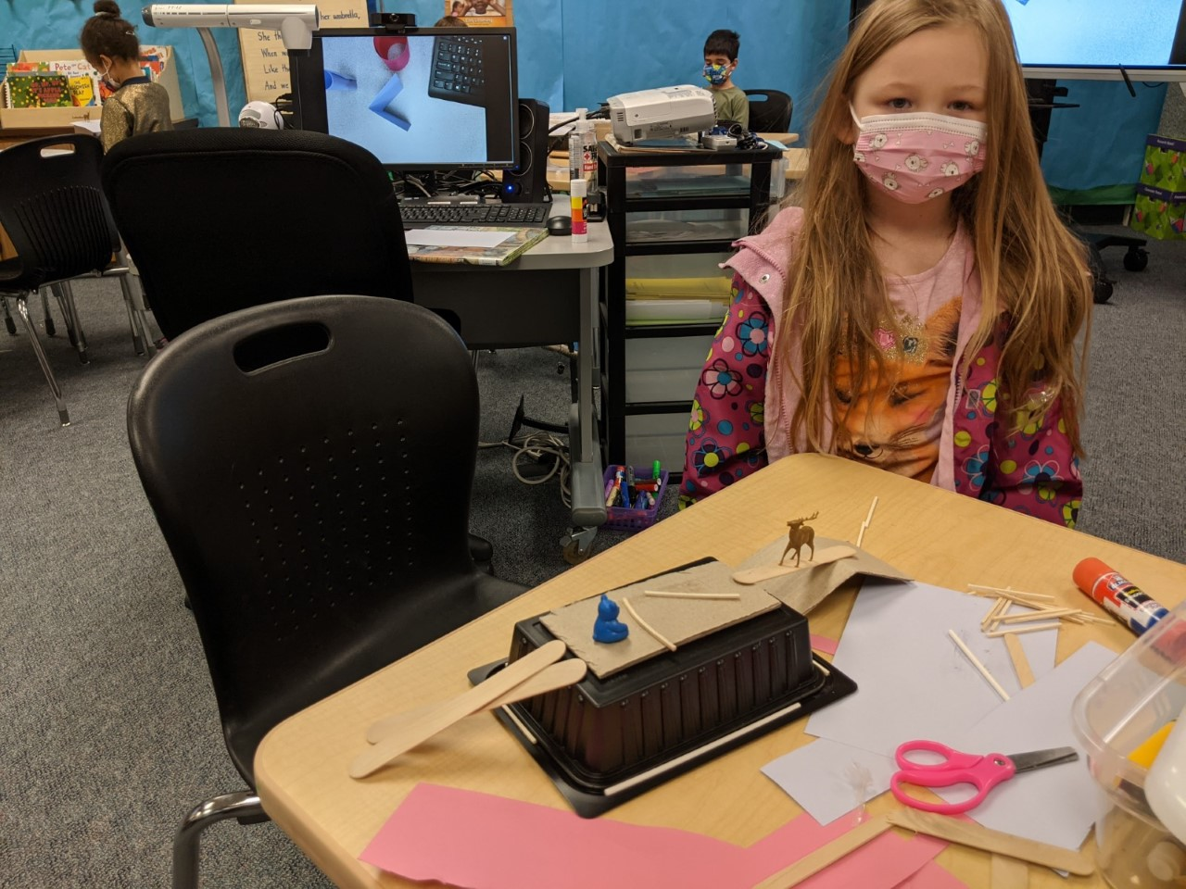
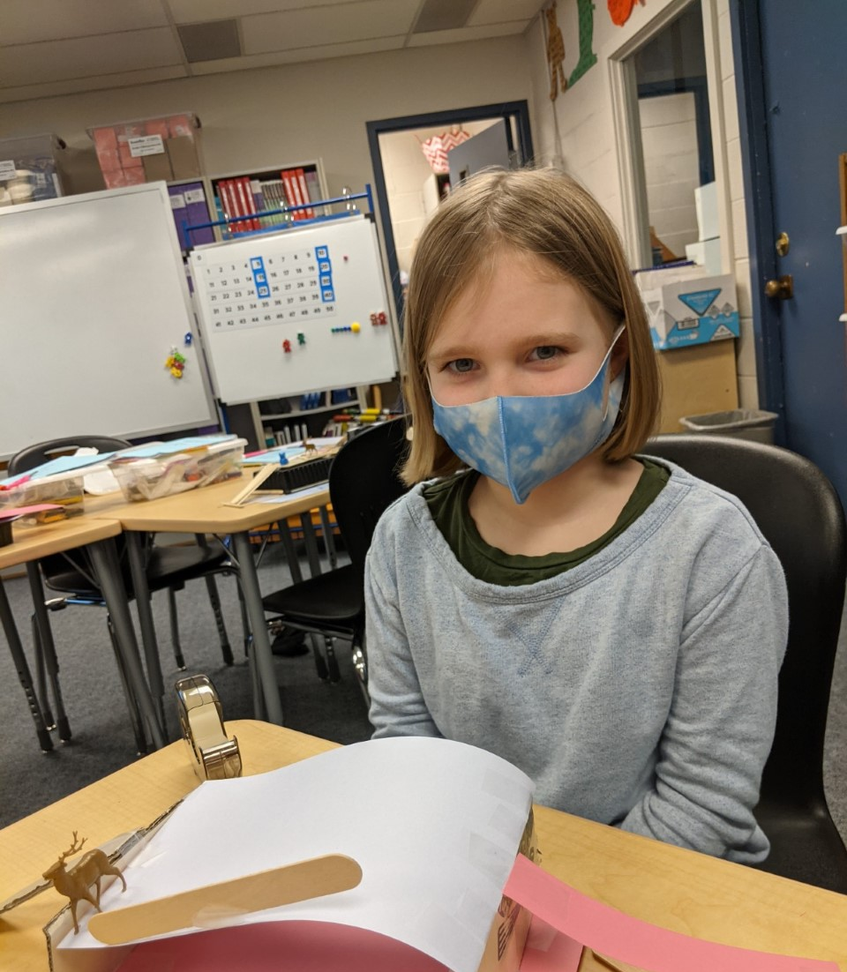
The students demonstrated collaboration, creativity and risk-taking as they designed their bridges! It is fascinating to see how many different designs the students came up with!
"A Sticky Situation"
Kindergarten

Slide 6
"Numbers to 99"
First and Second Grade

Slide 7
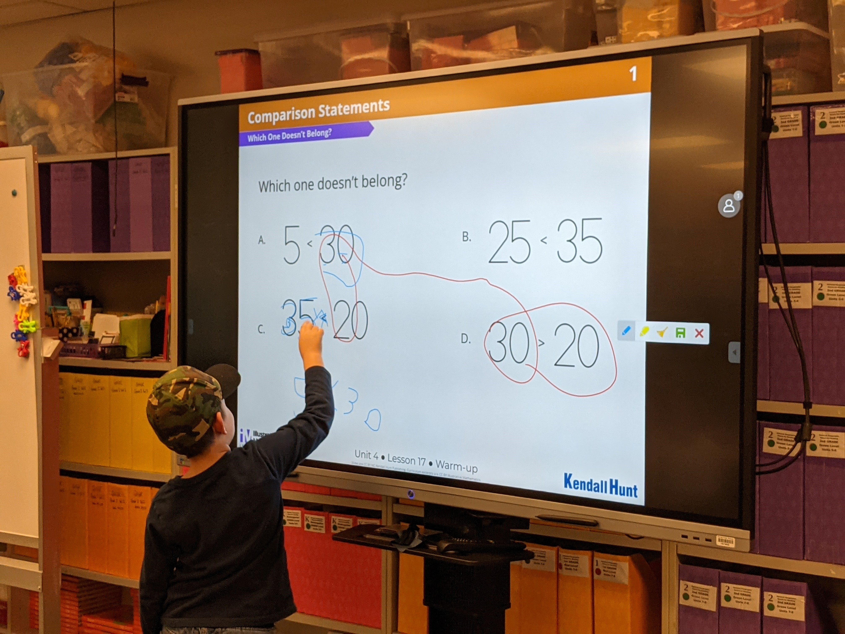
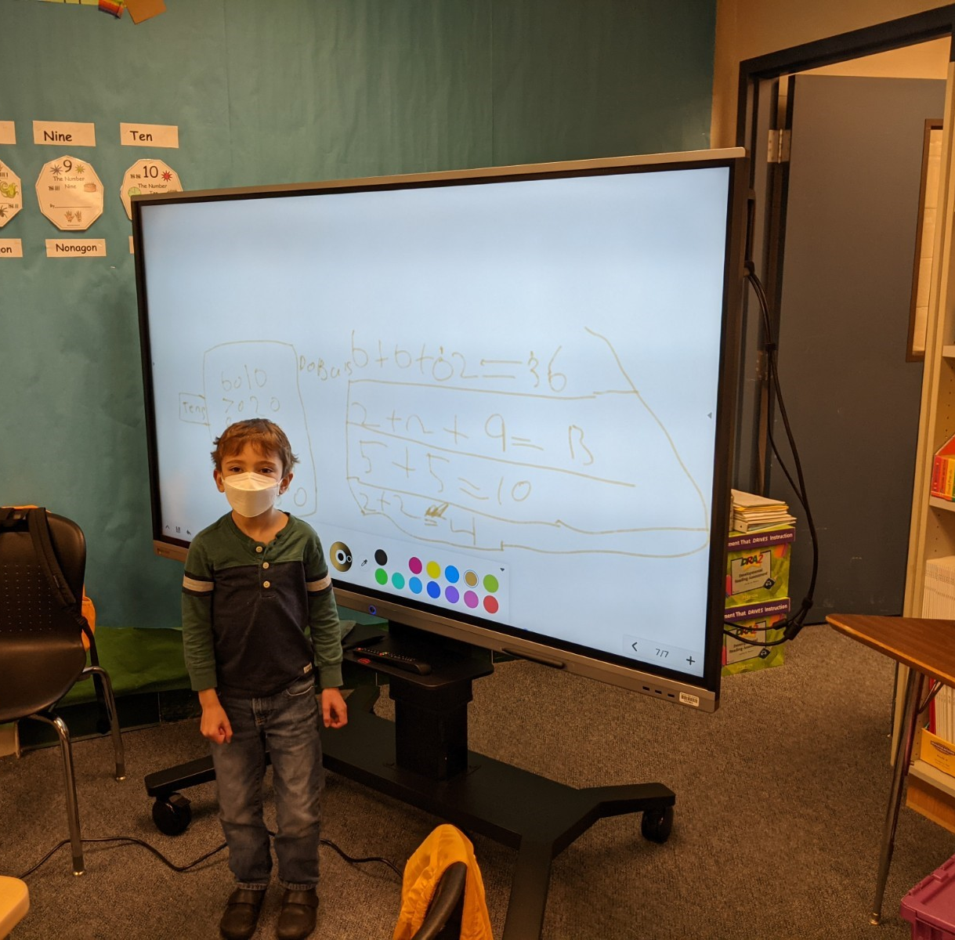
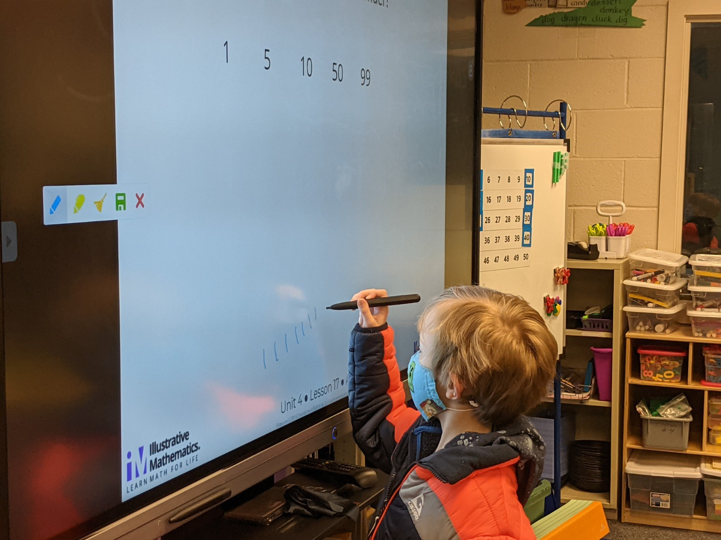
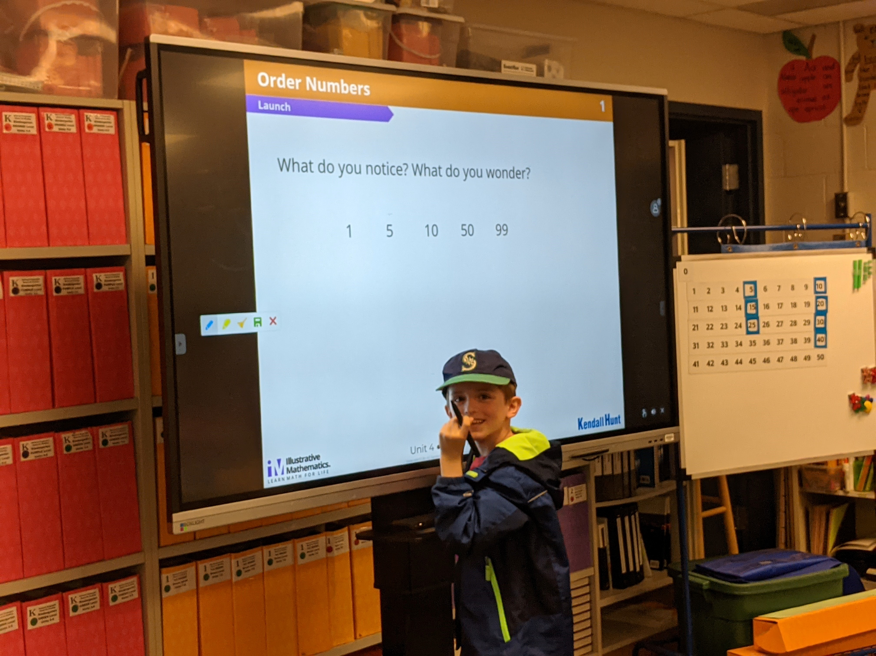
Students use the interactive Box Light Board to show their problem solving strategies with the class
"Numbers to 99"​
First-Second Grade

Slide 8
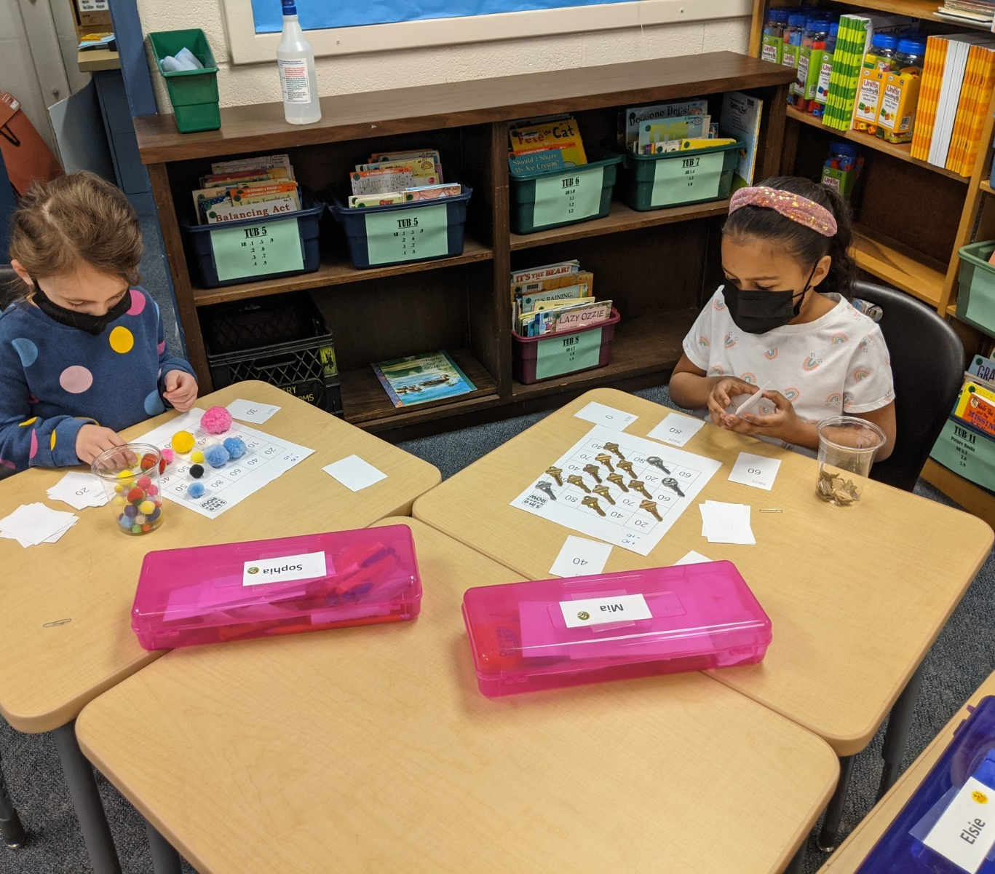
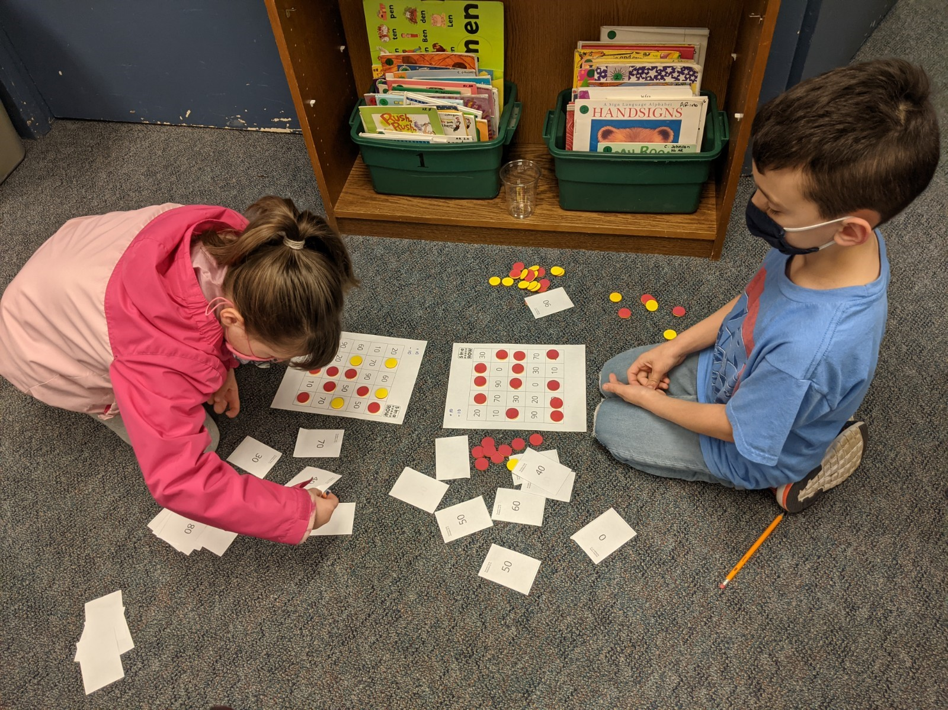
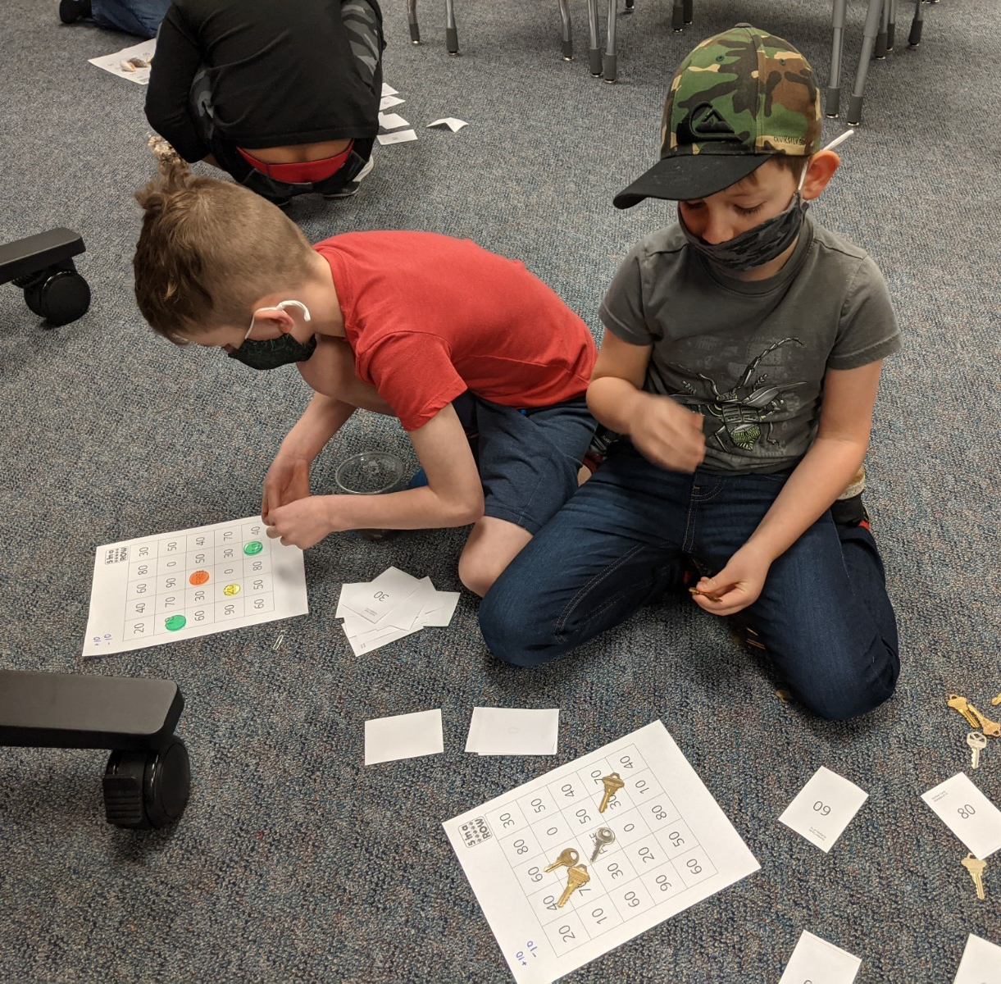
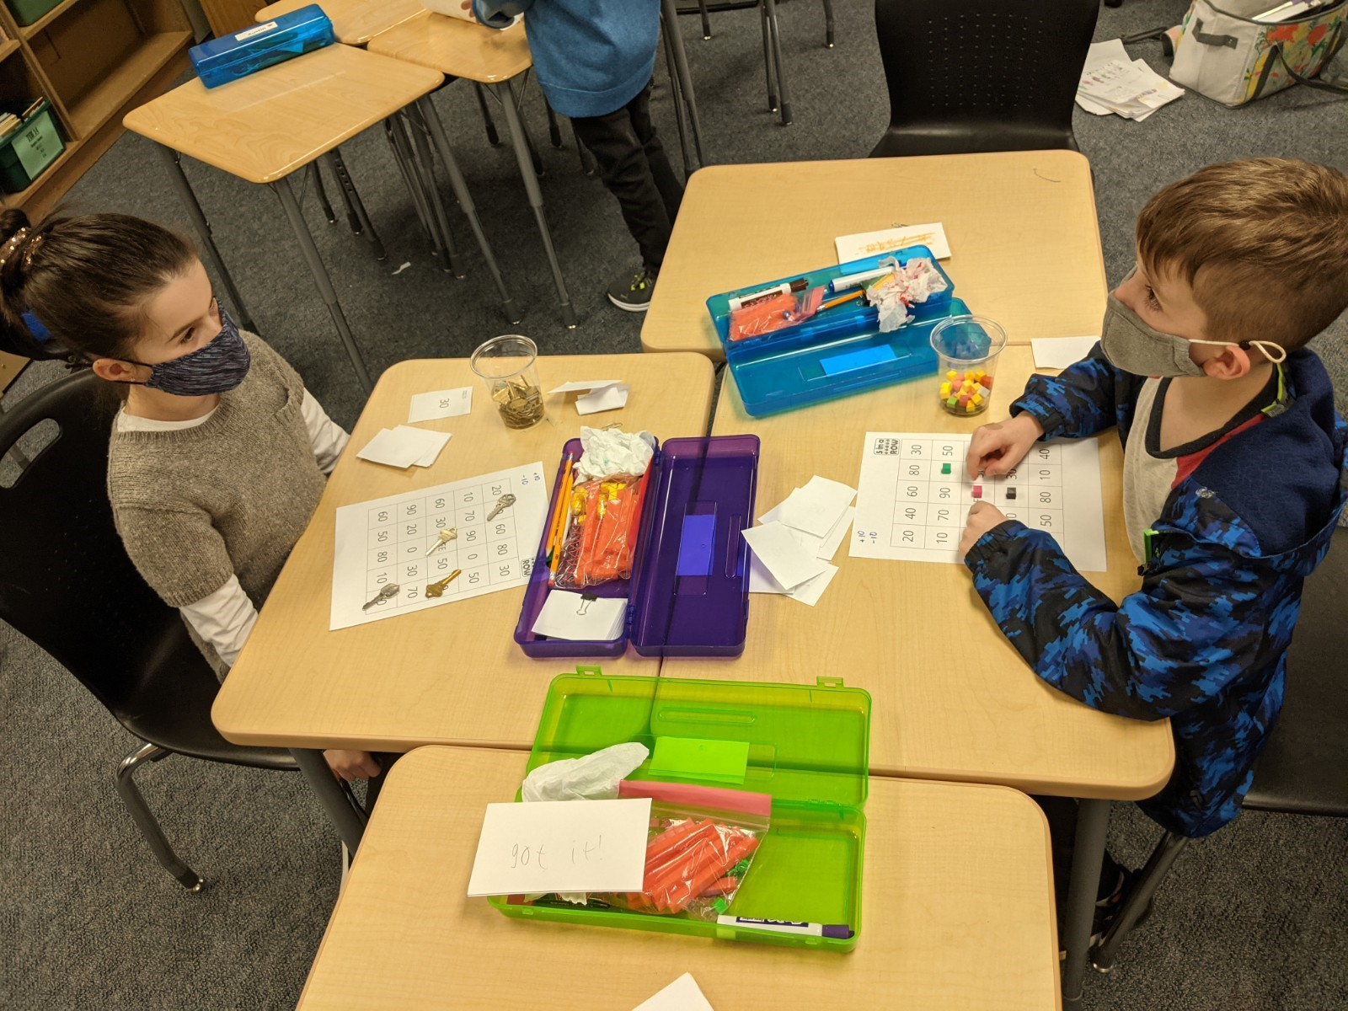
"Numbers to 99"​​
First-Second Grade
Students play math games to reinforce math fact skills. This game is called "Five in a Row" and is similar to bingo, but students do computation to figure out each number that they get to cover!

Slide 9
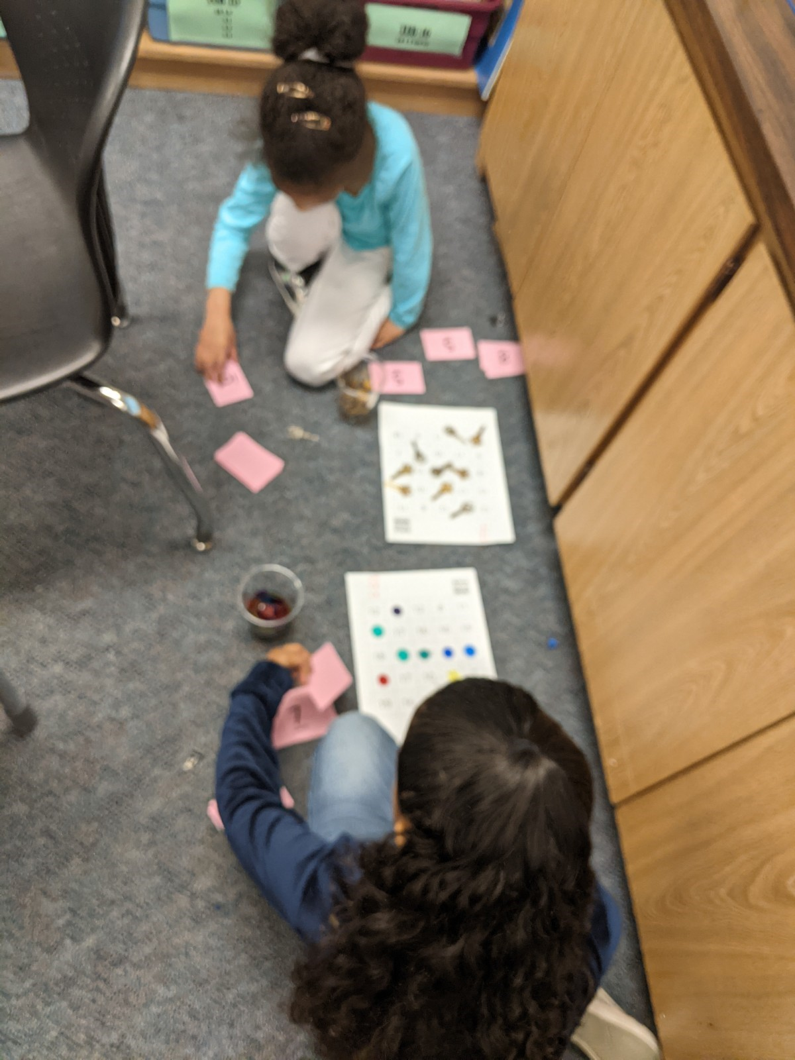
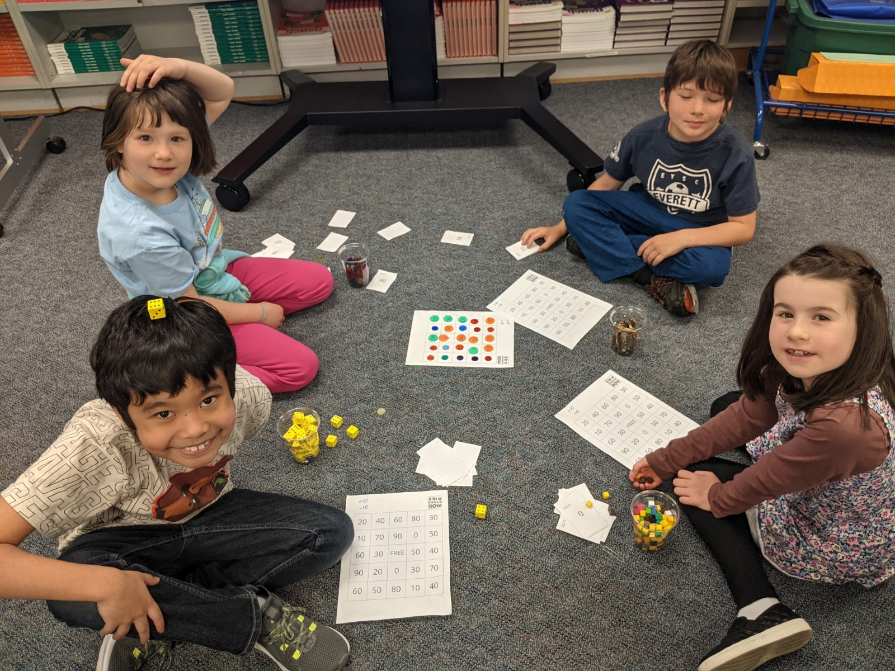
"Numbers to 99"​​​
First-Second Grade
More Math Games!

Slide 10
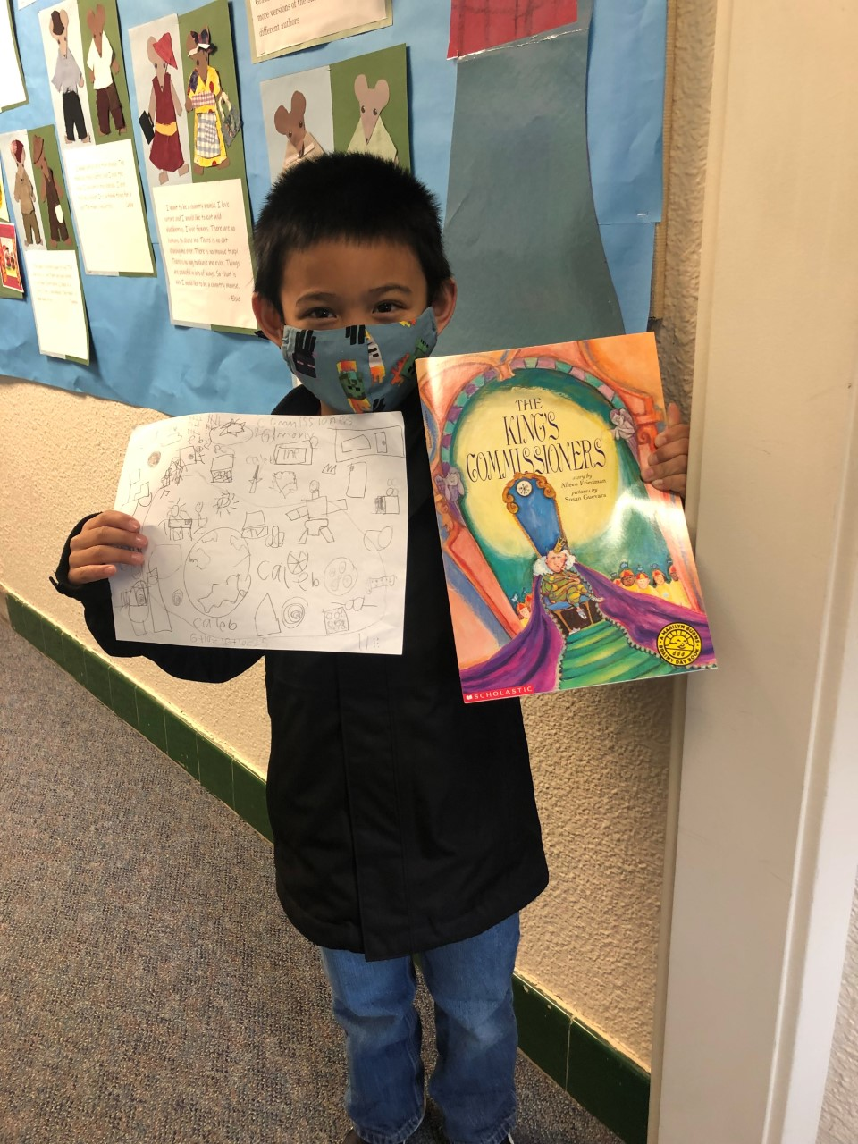
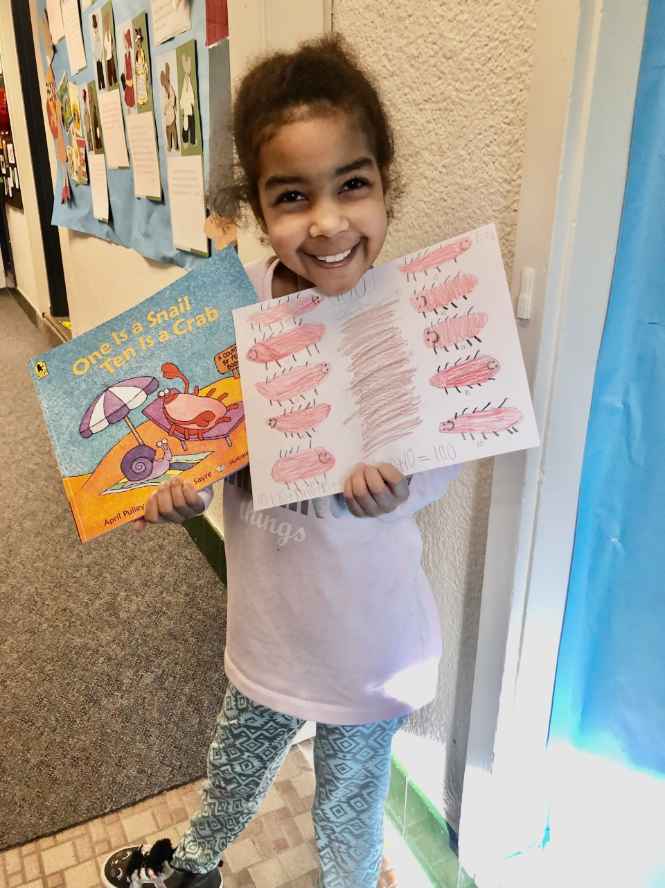
"Numbers to 99"​​​​
First-Second Grade
Inspired by literature, students practice problem solving strategies using prompts connected to our stories. Check out the wall of our classroom for examples of their work!

Slide 11
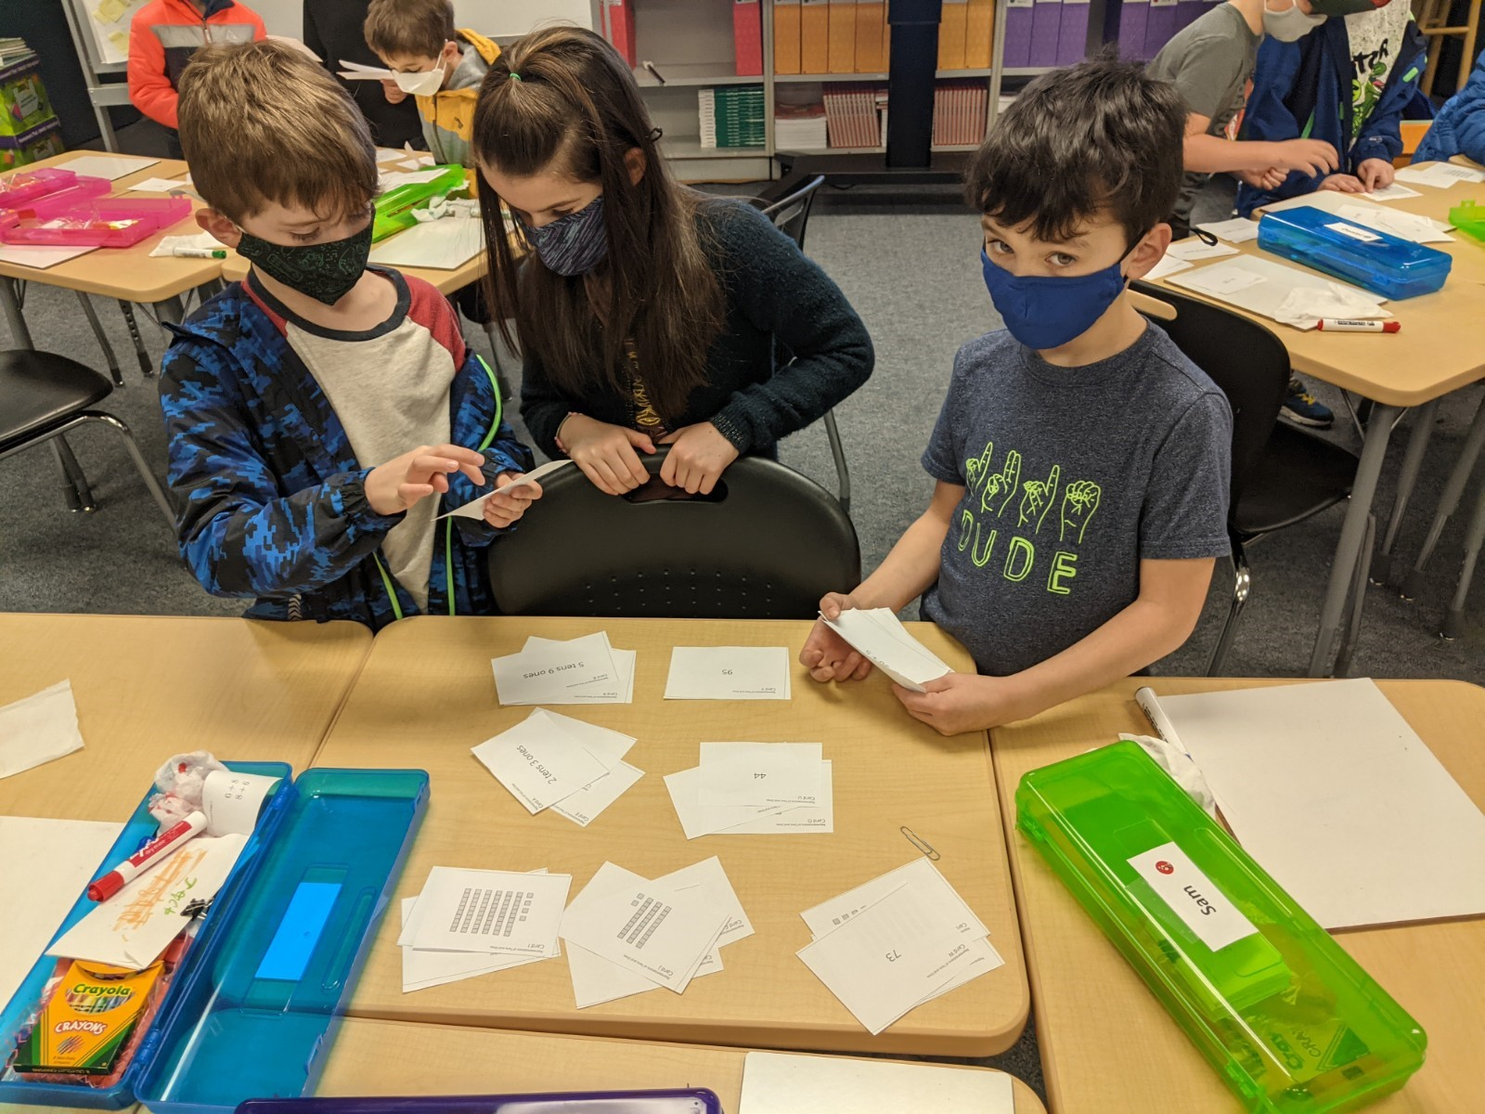
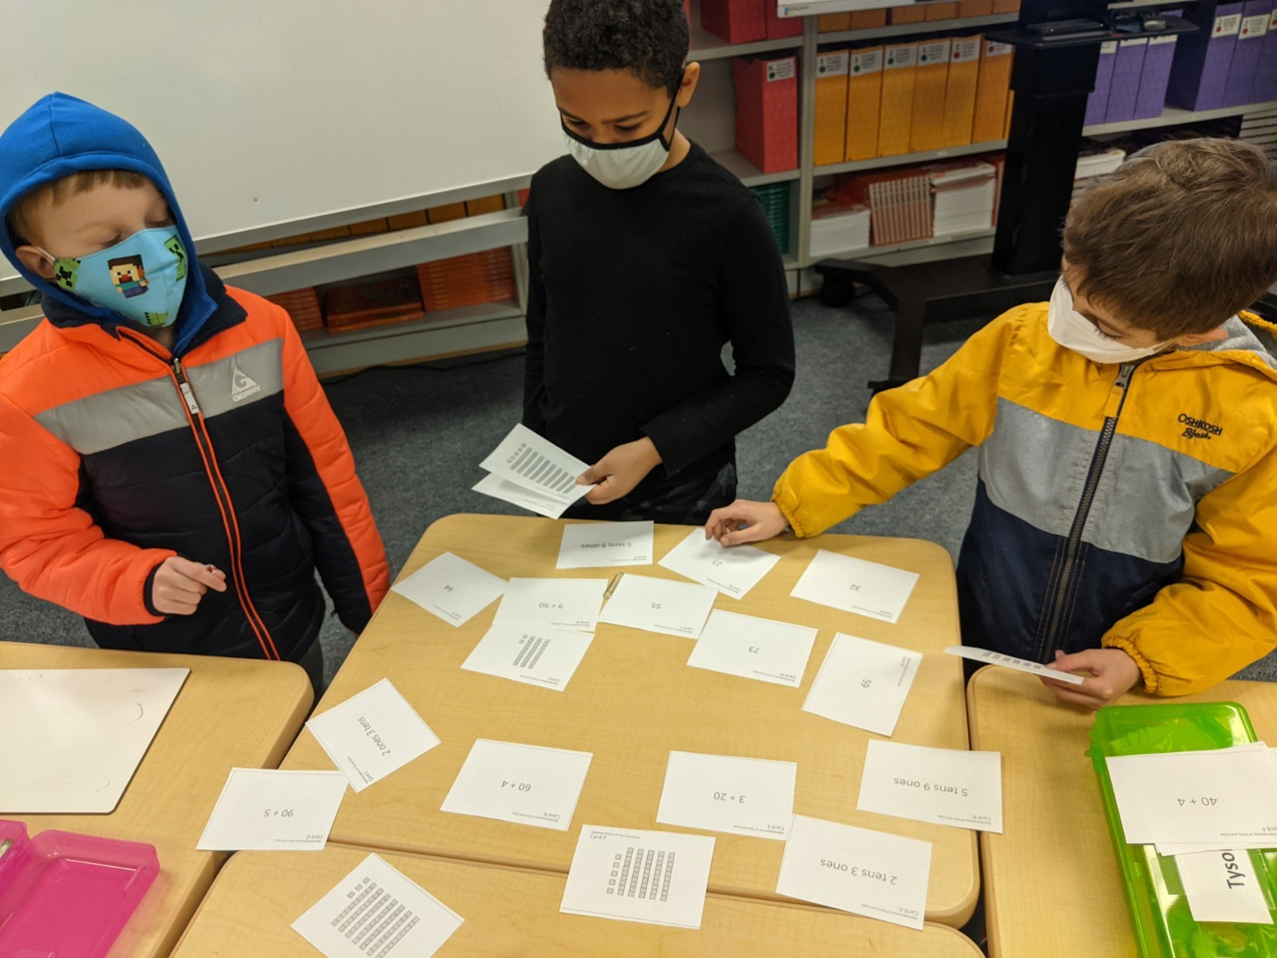
"Numbers to 99"​​
First-Second Grade
Students work as a team to sort and match different ways of showing numbers.

Slide 12
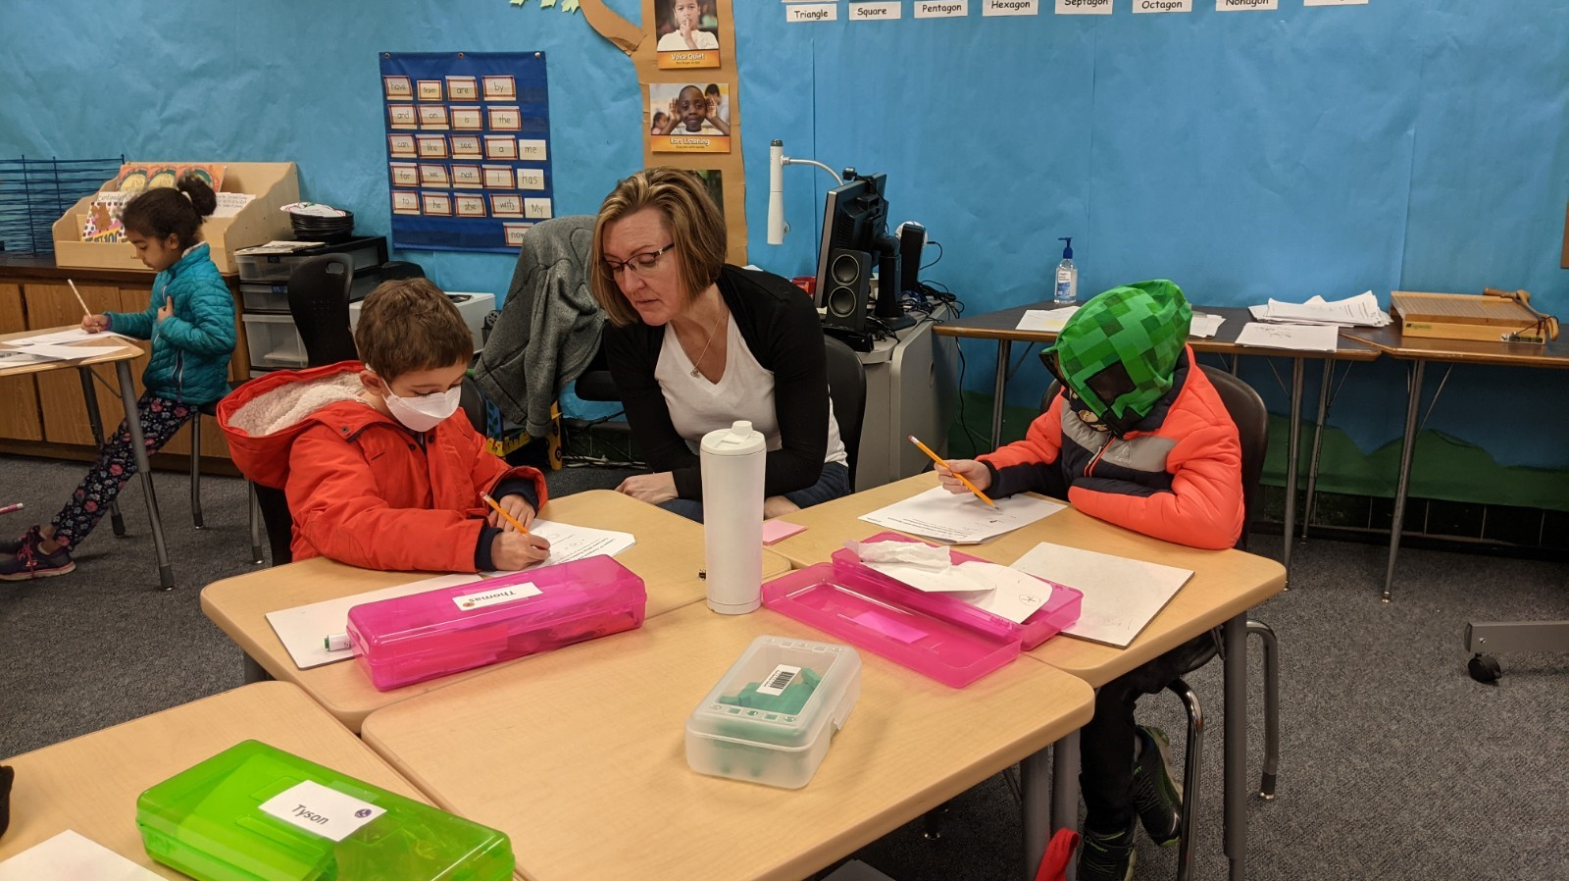
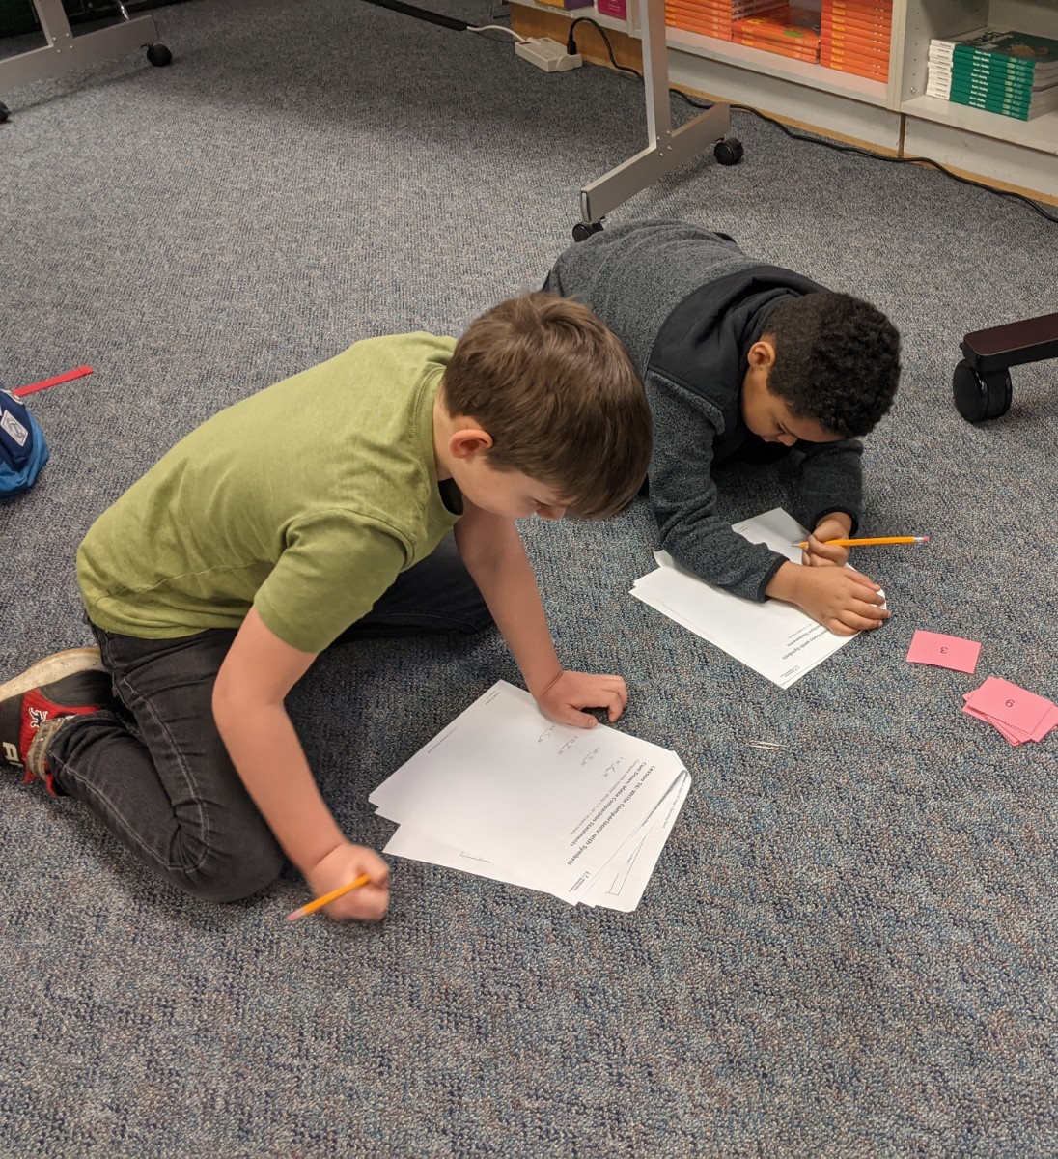
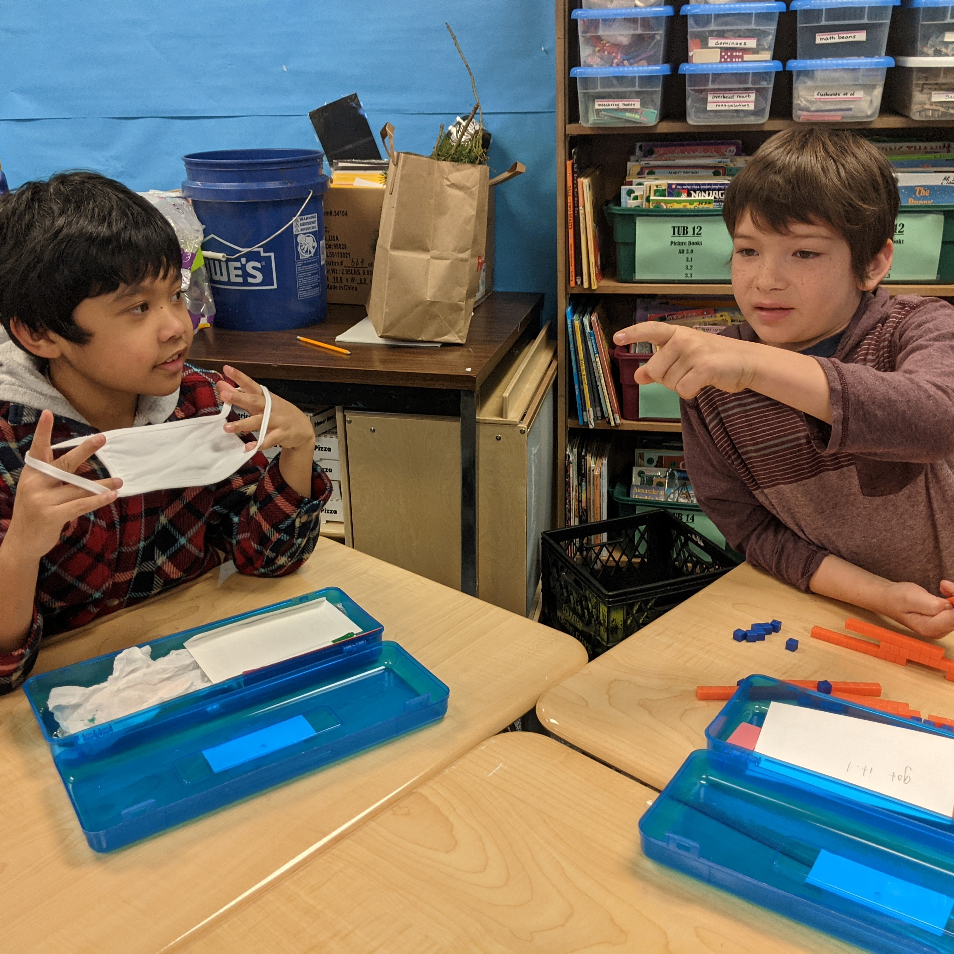
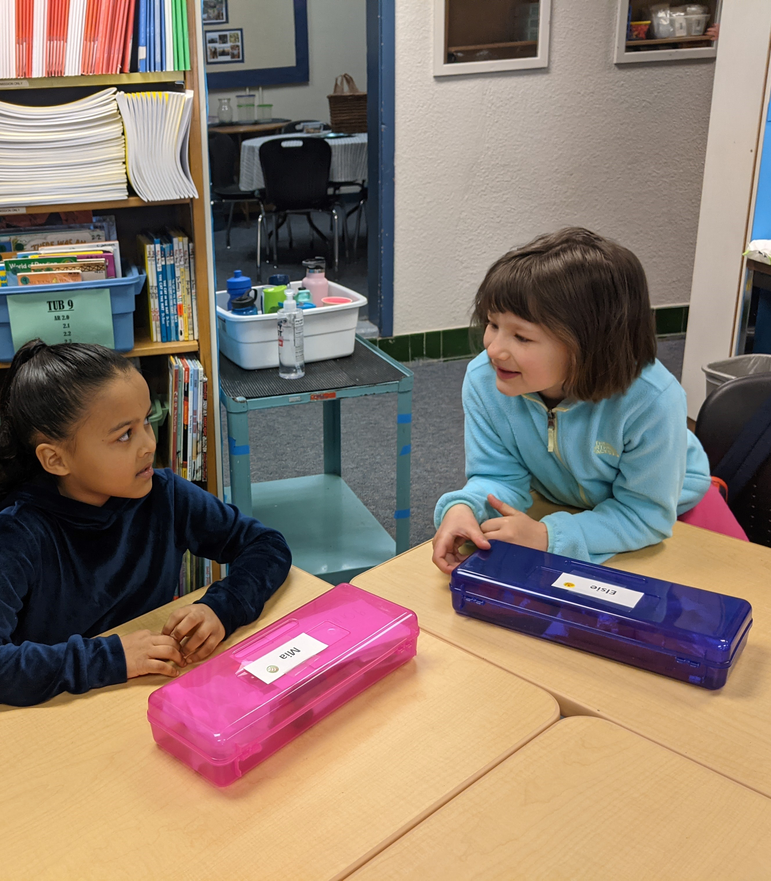
"Numbers to 99"​​
First-Second Grade
Lots of engaging conversations about math strategies!

Slide 13
"Animals 2x2"
@ The Lively Environmental Center
Kindergarten-First Grade

Slide 14
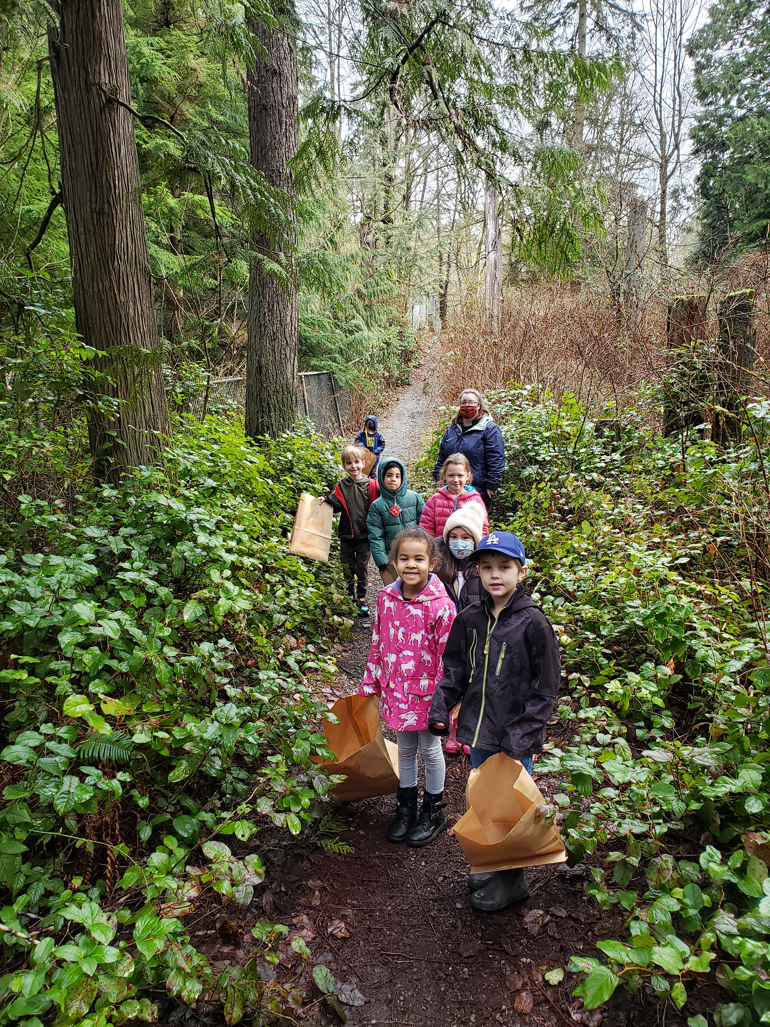
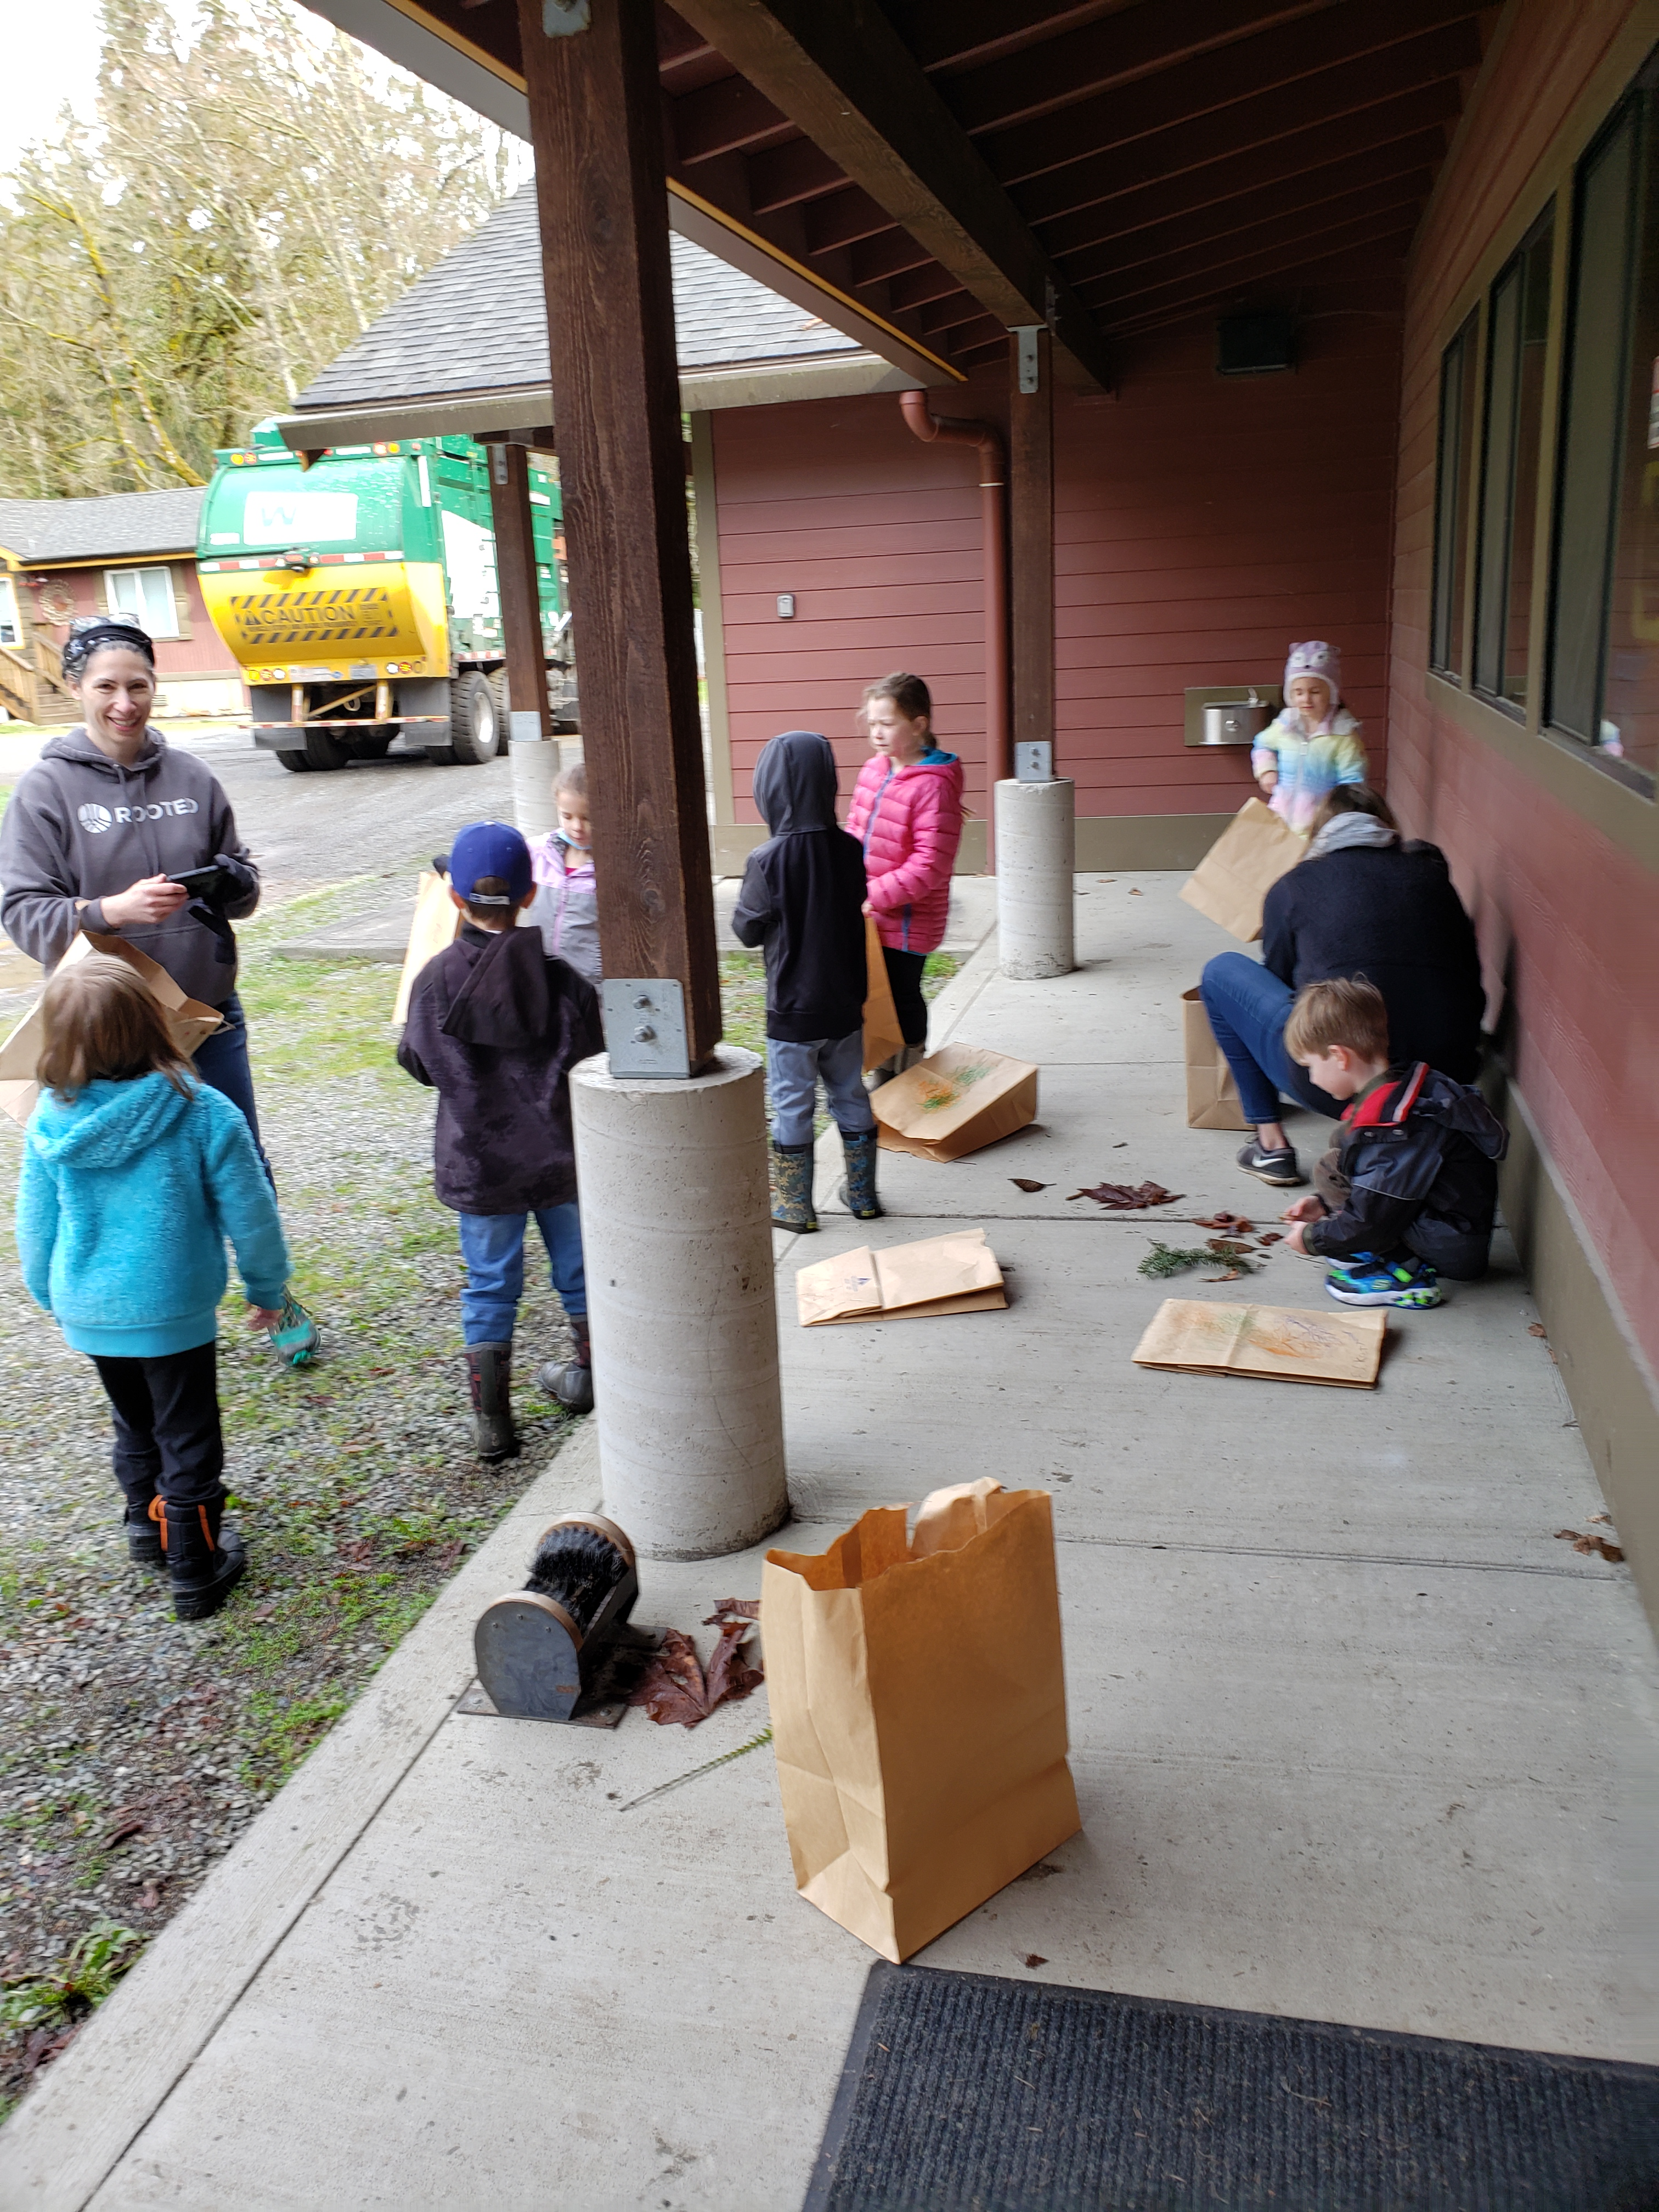
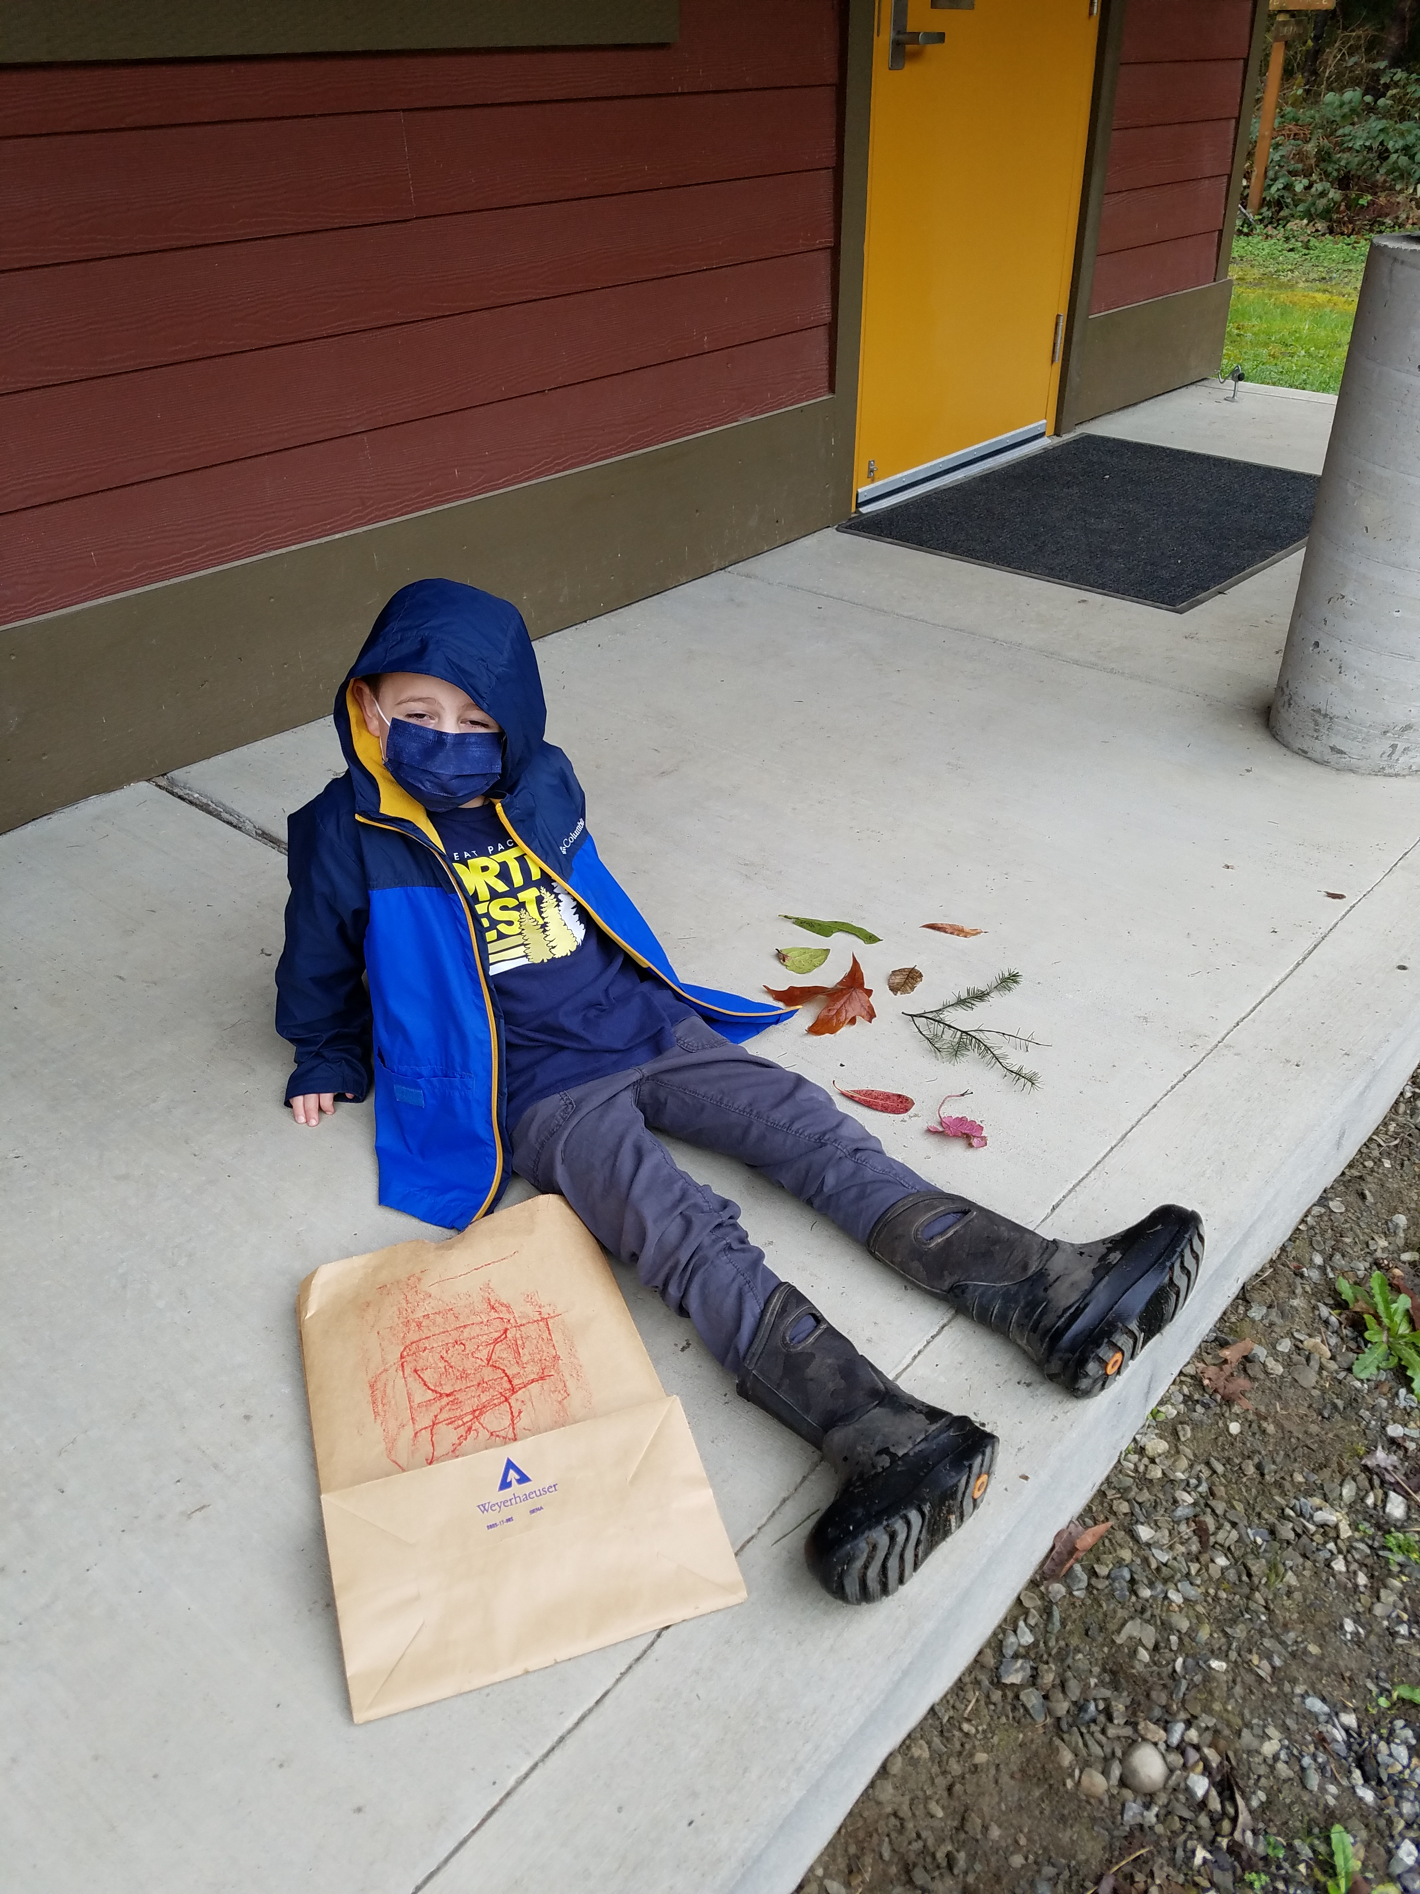
"Animals 2x2"
@ the Lively Environmental Center
Kindergarten-First Grade
We went on a leaf hunt, observed, compared and sorted the different types of leaves

Slide 15
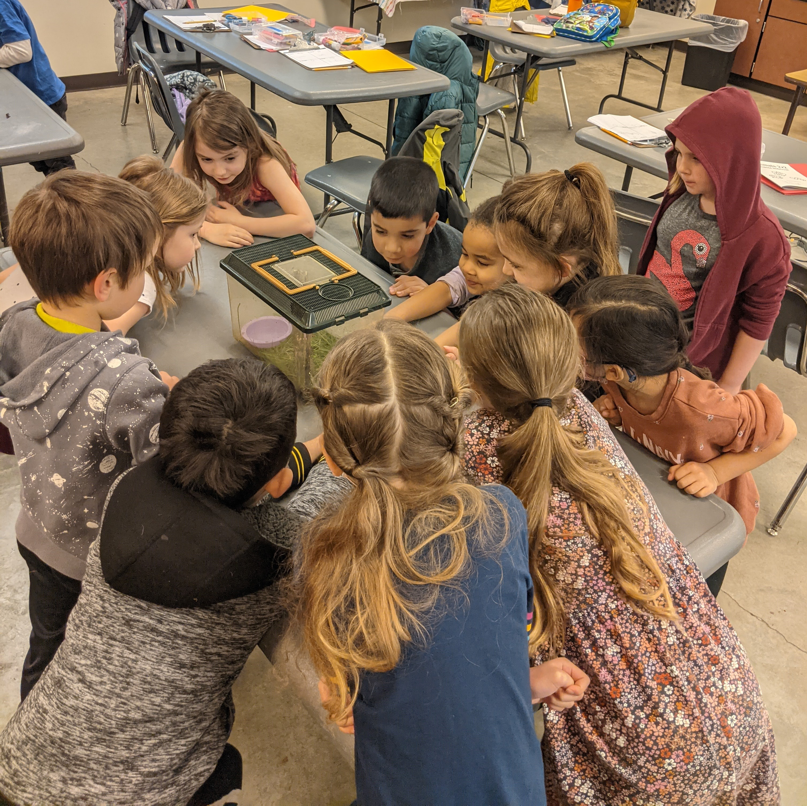
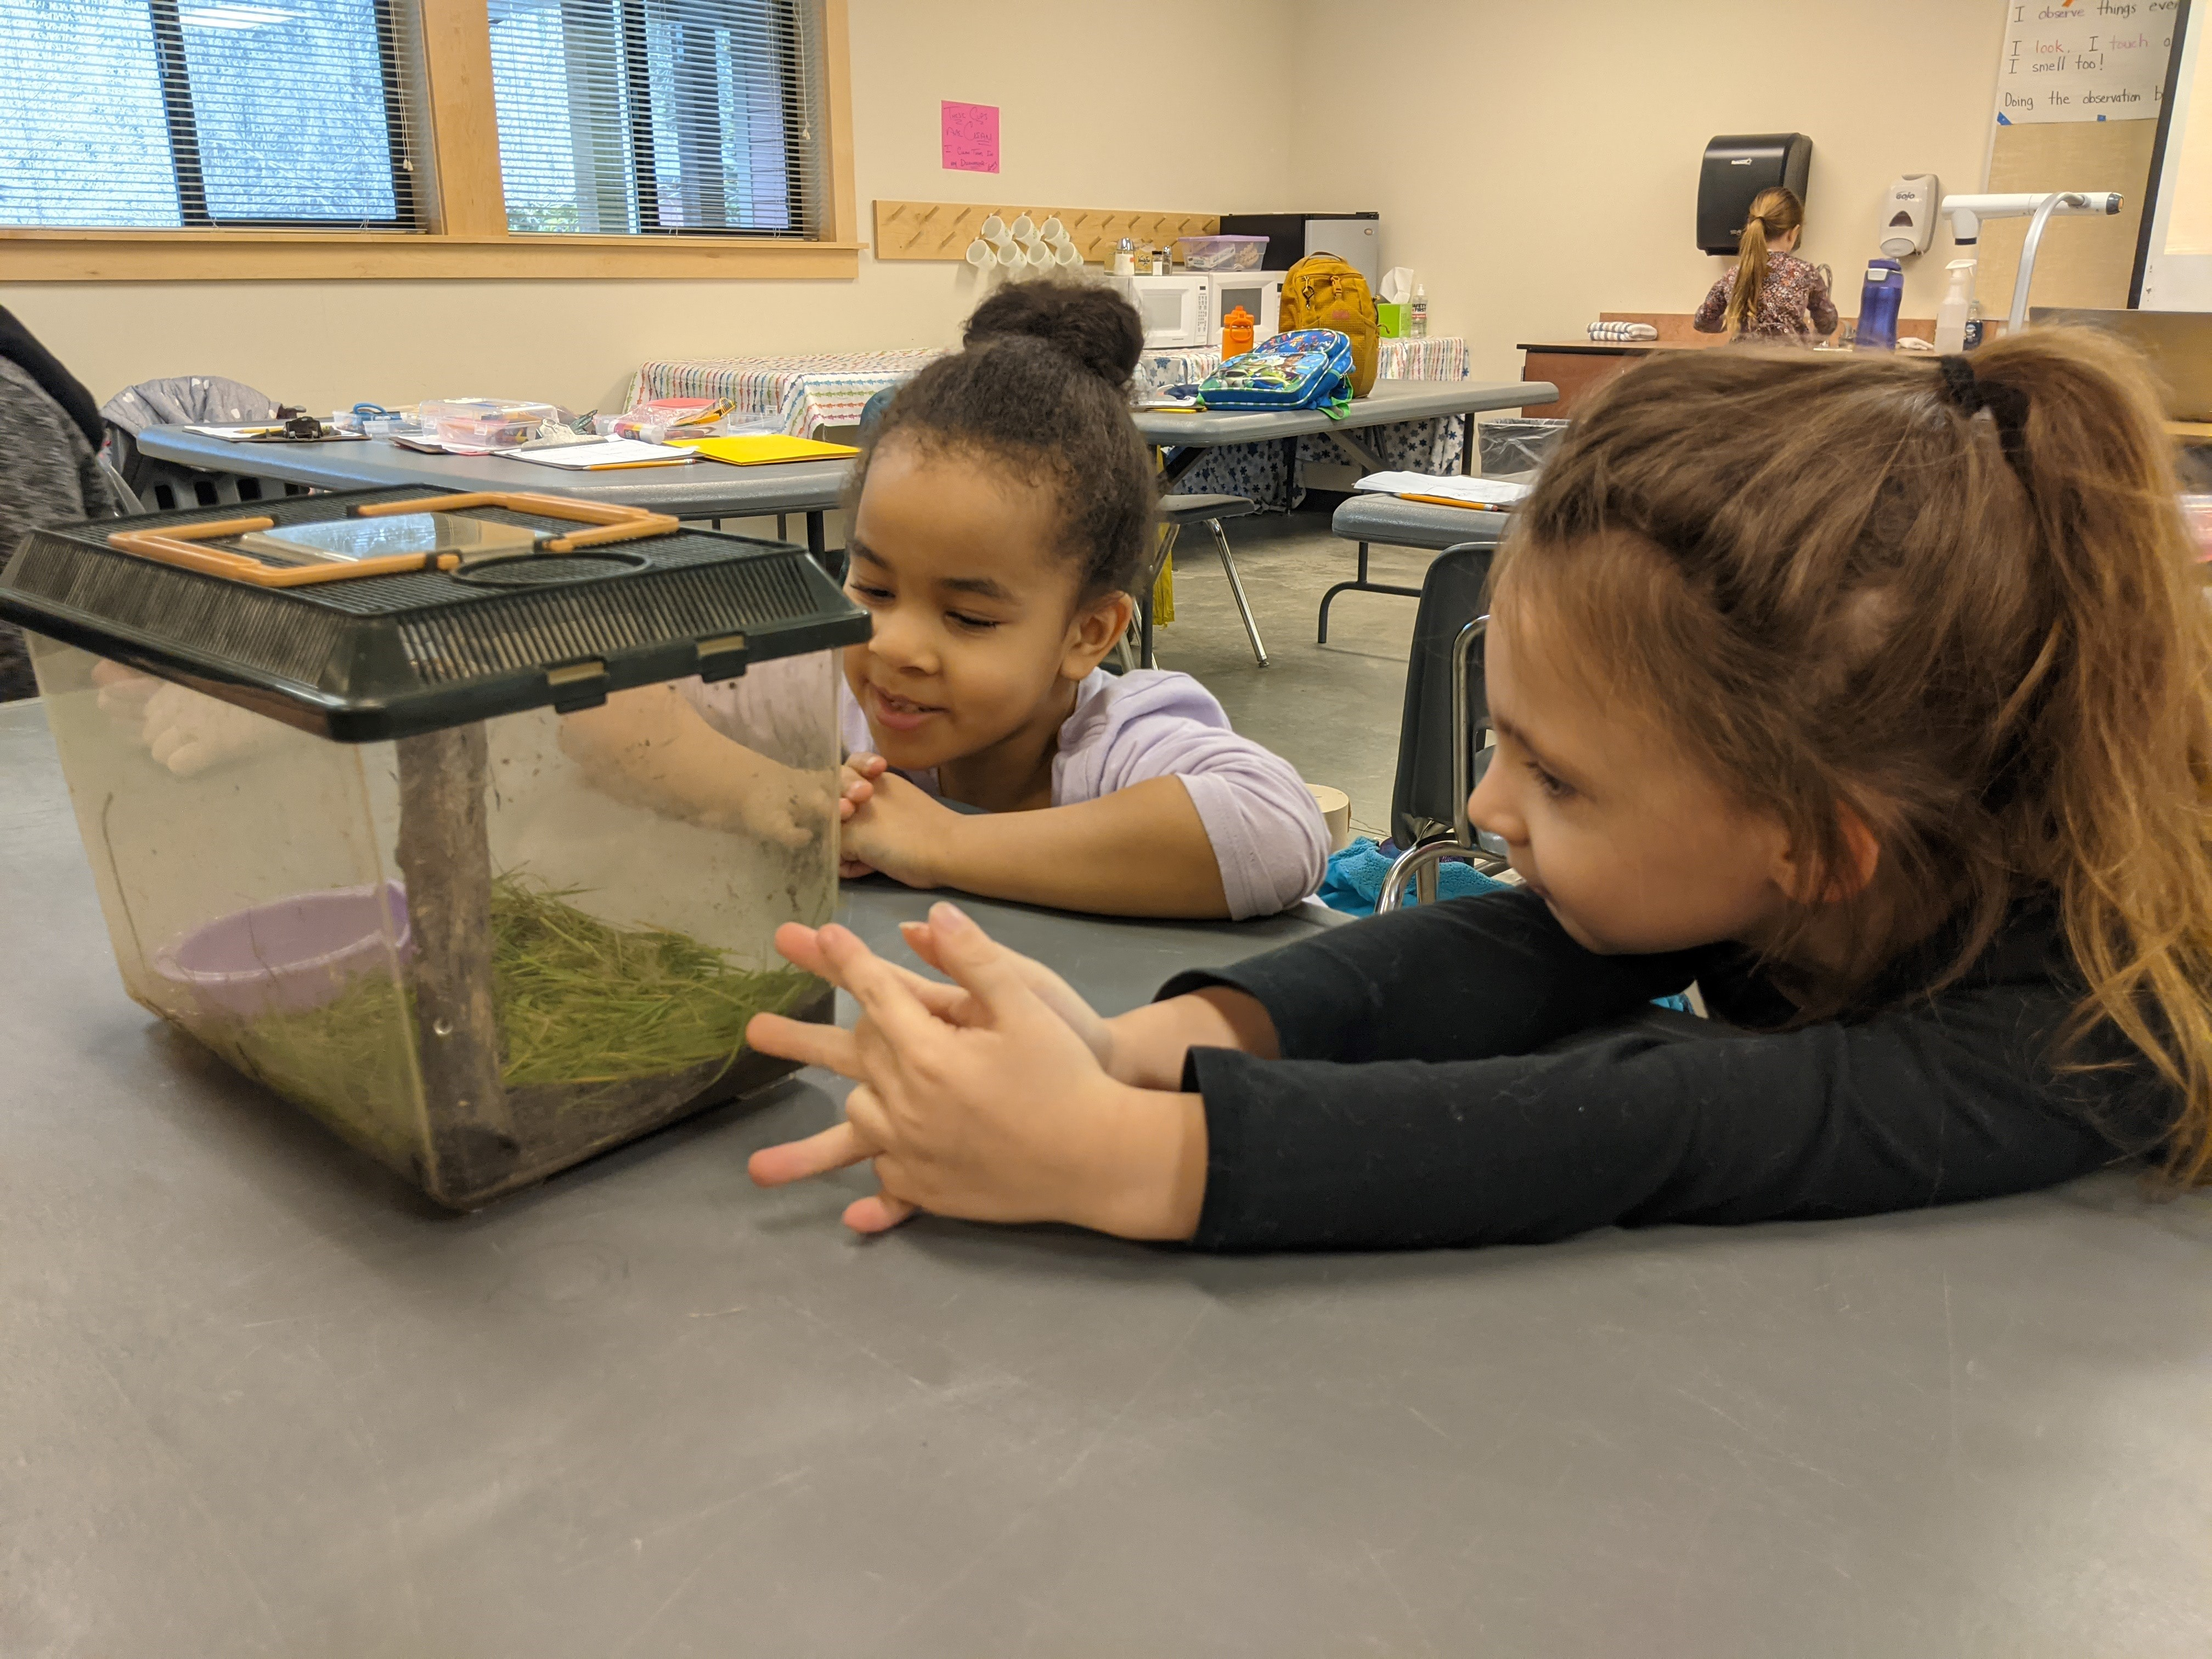
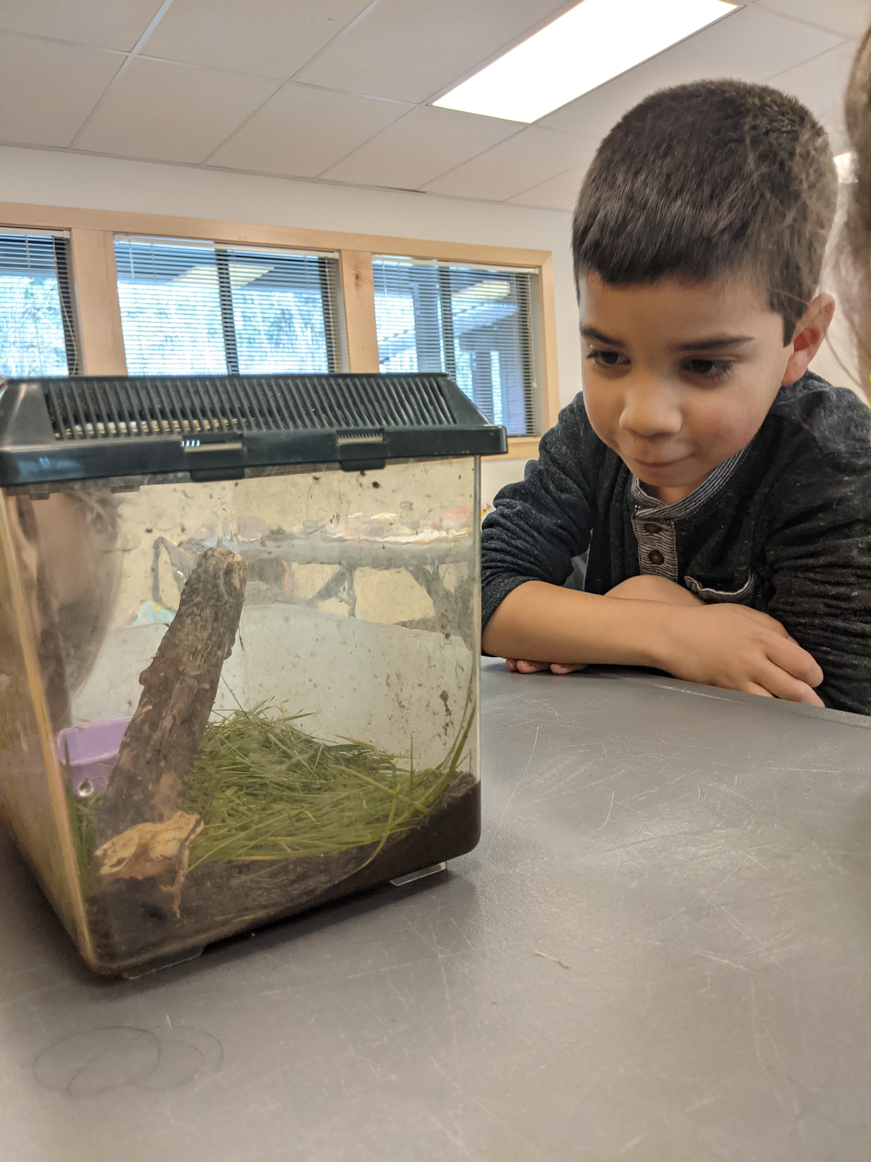
"Animals 2x2"
@ the Lively Environmental Center
Kindergarten-First Grade
One of our students, Eva Binti, caught a frog at home and brought it to class! Her discovery was a class favorite!

Slide 16
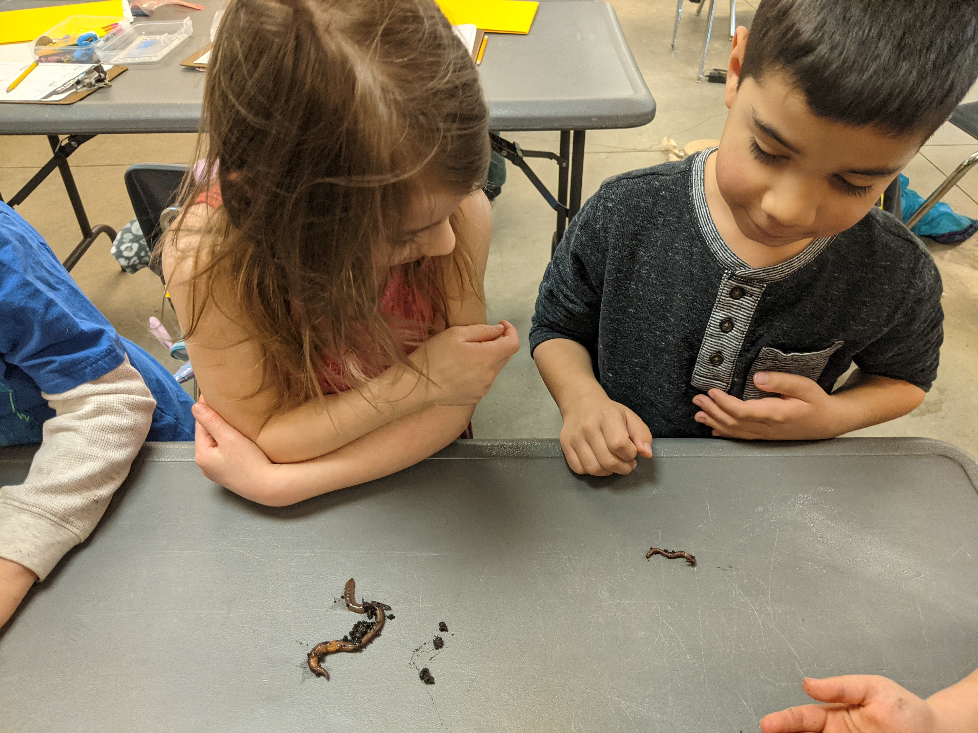
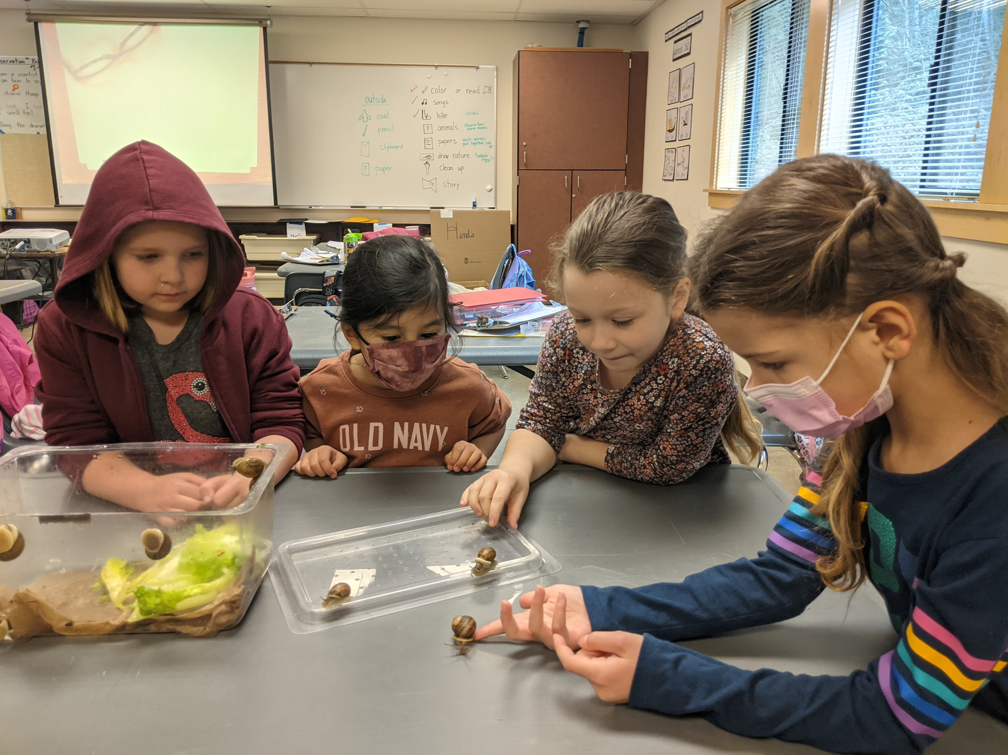
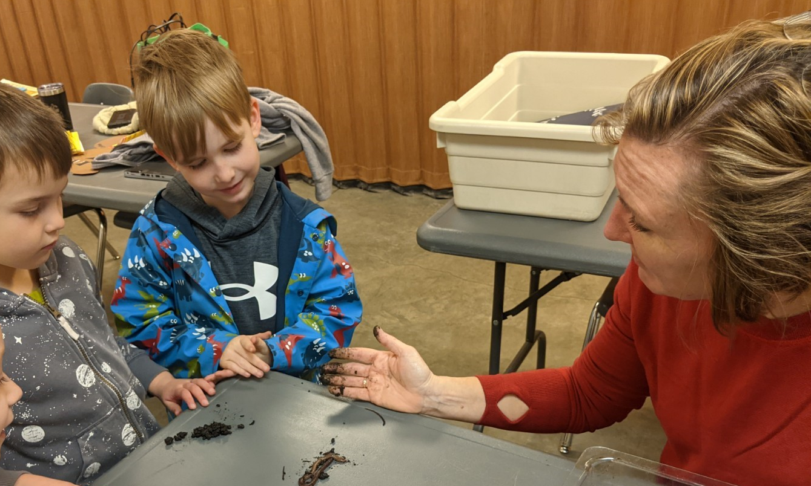
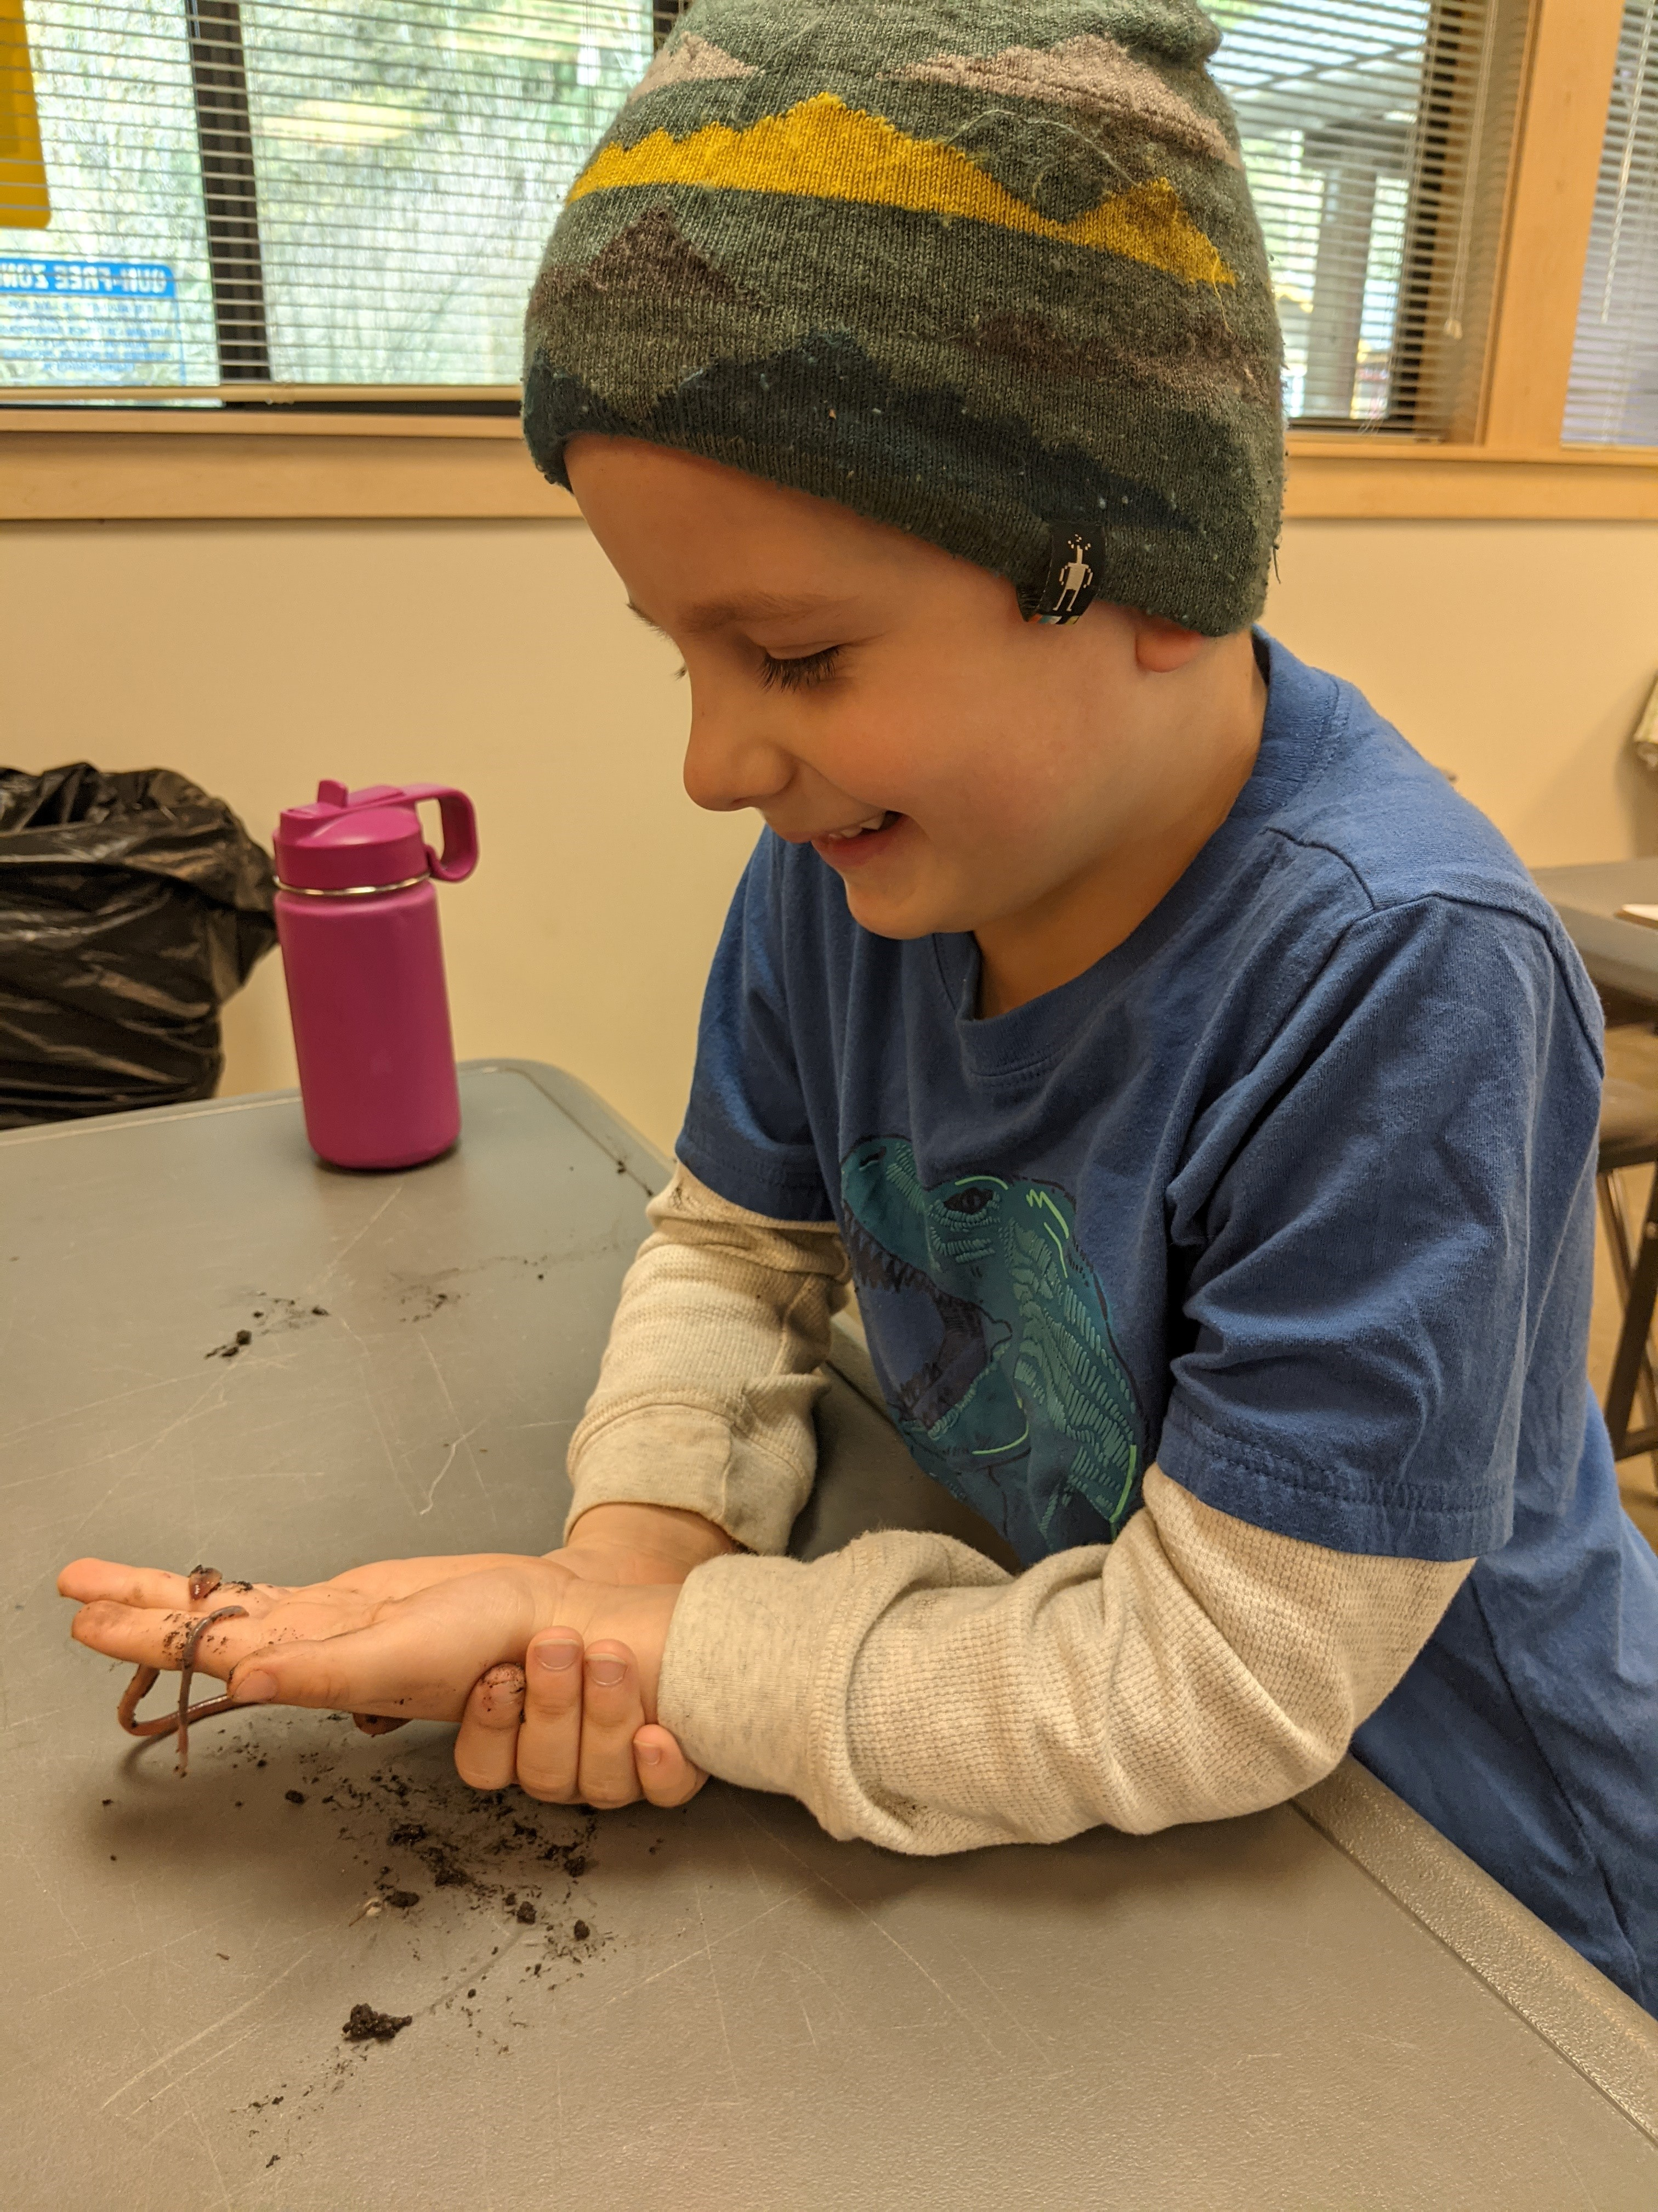
"Animals 2x2"
@ the Lively Environmental Center
Kindergarten-First Grade
We compare similar, but different types of animals:
red worms vs earthworms
guppies vs goldfish
land snails vs water snails

Slide 17
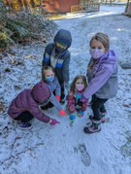
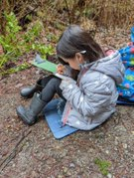
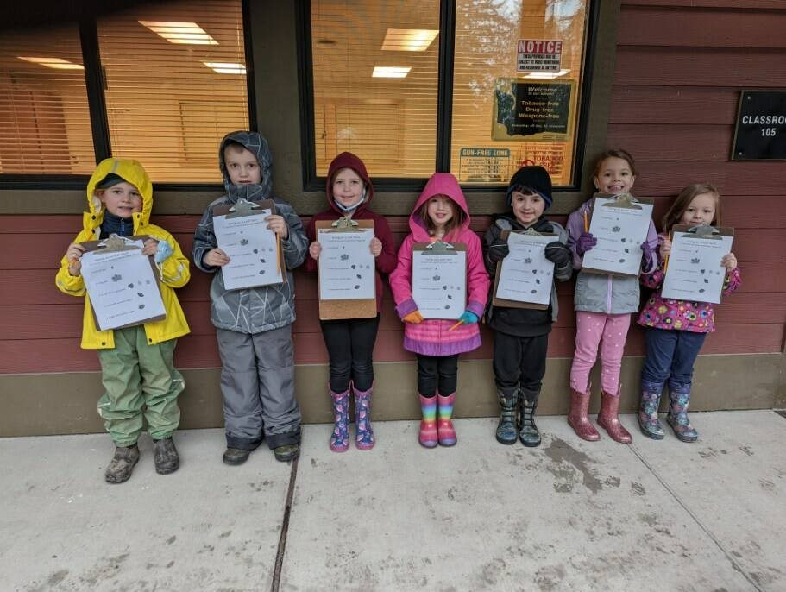
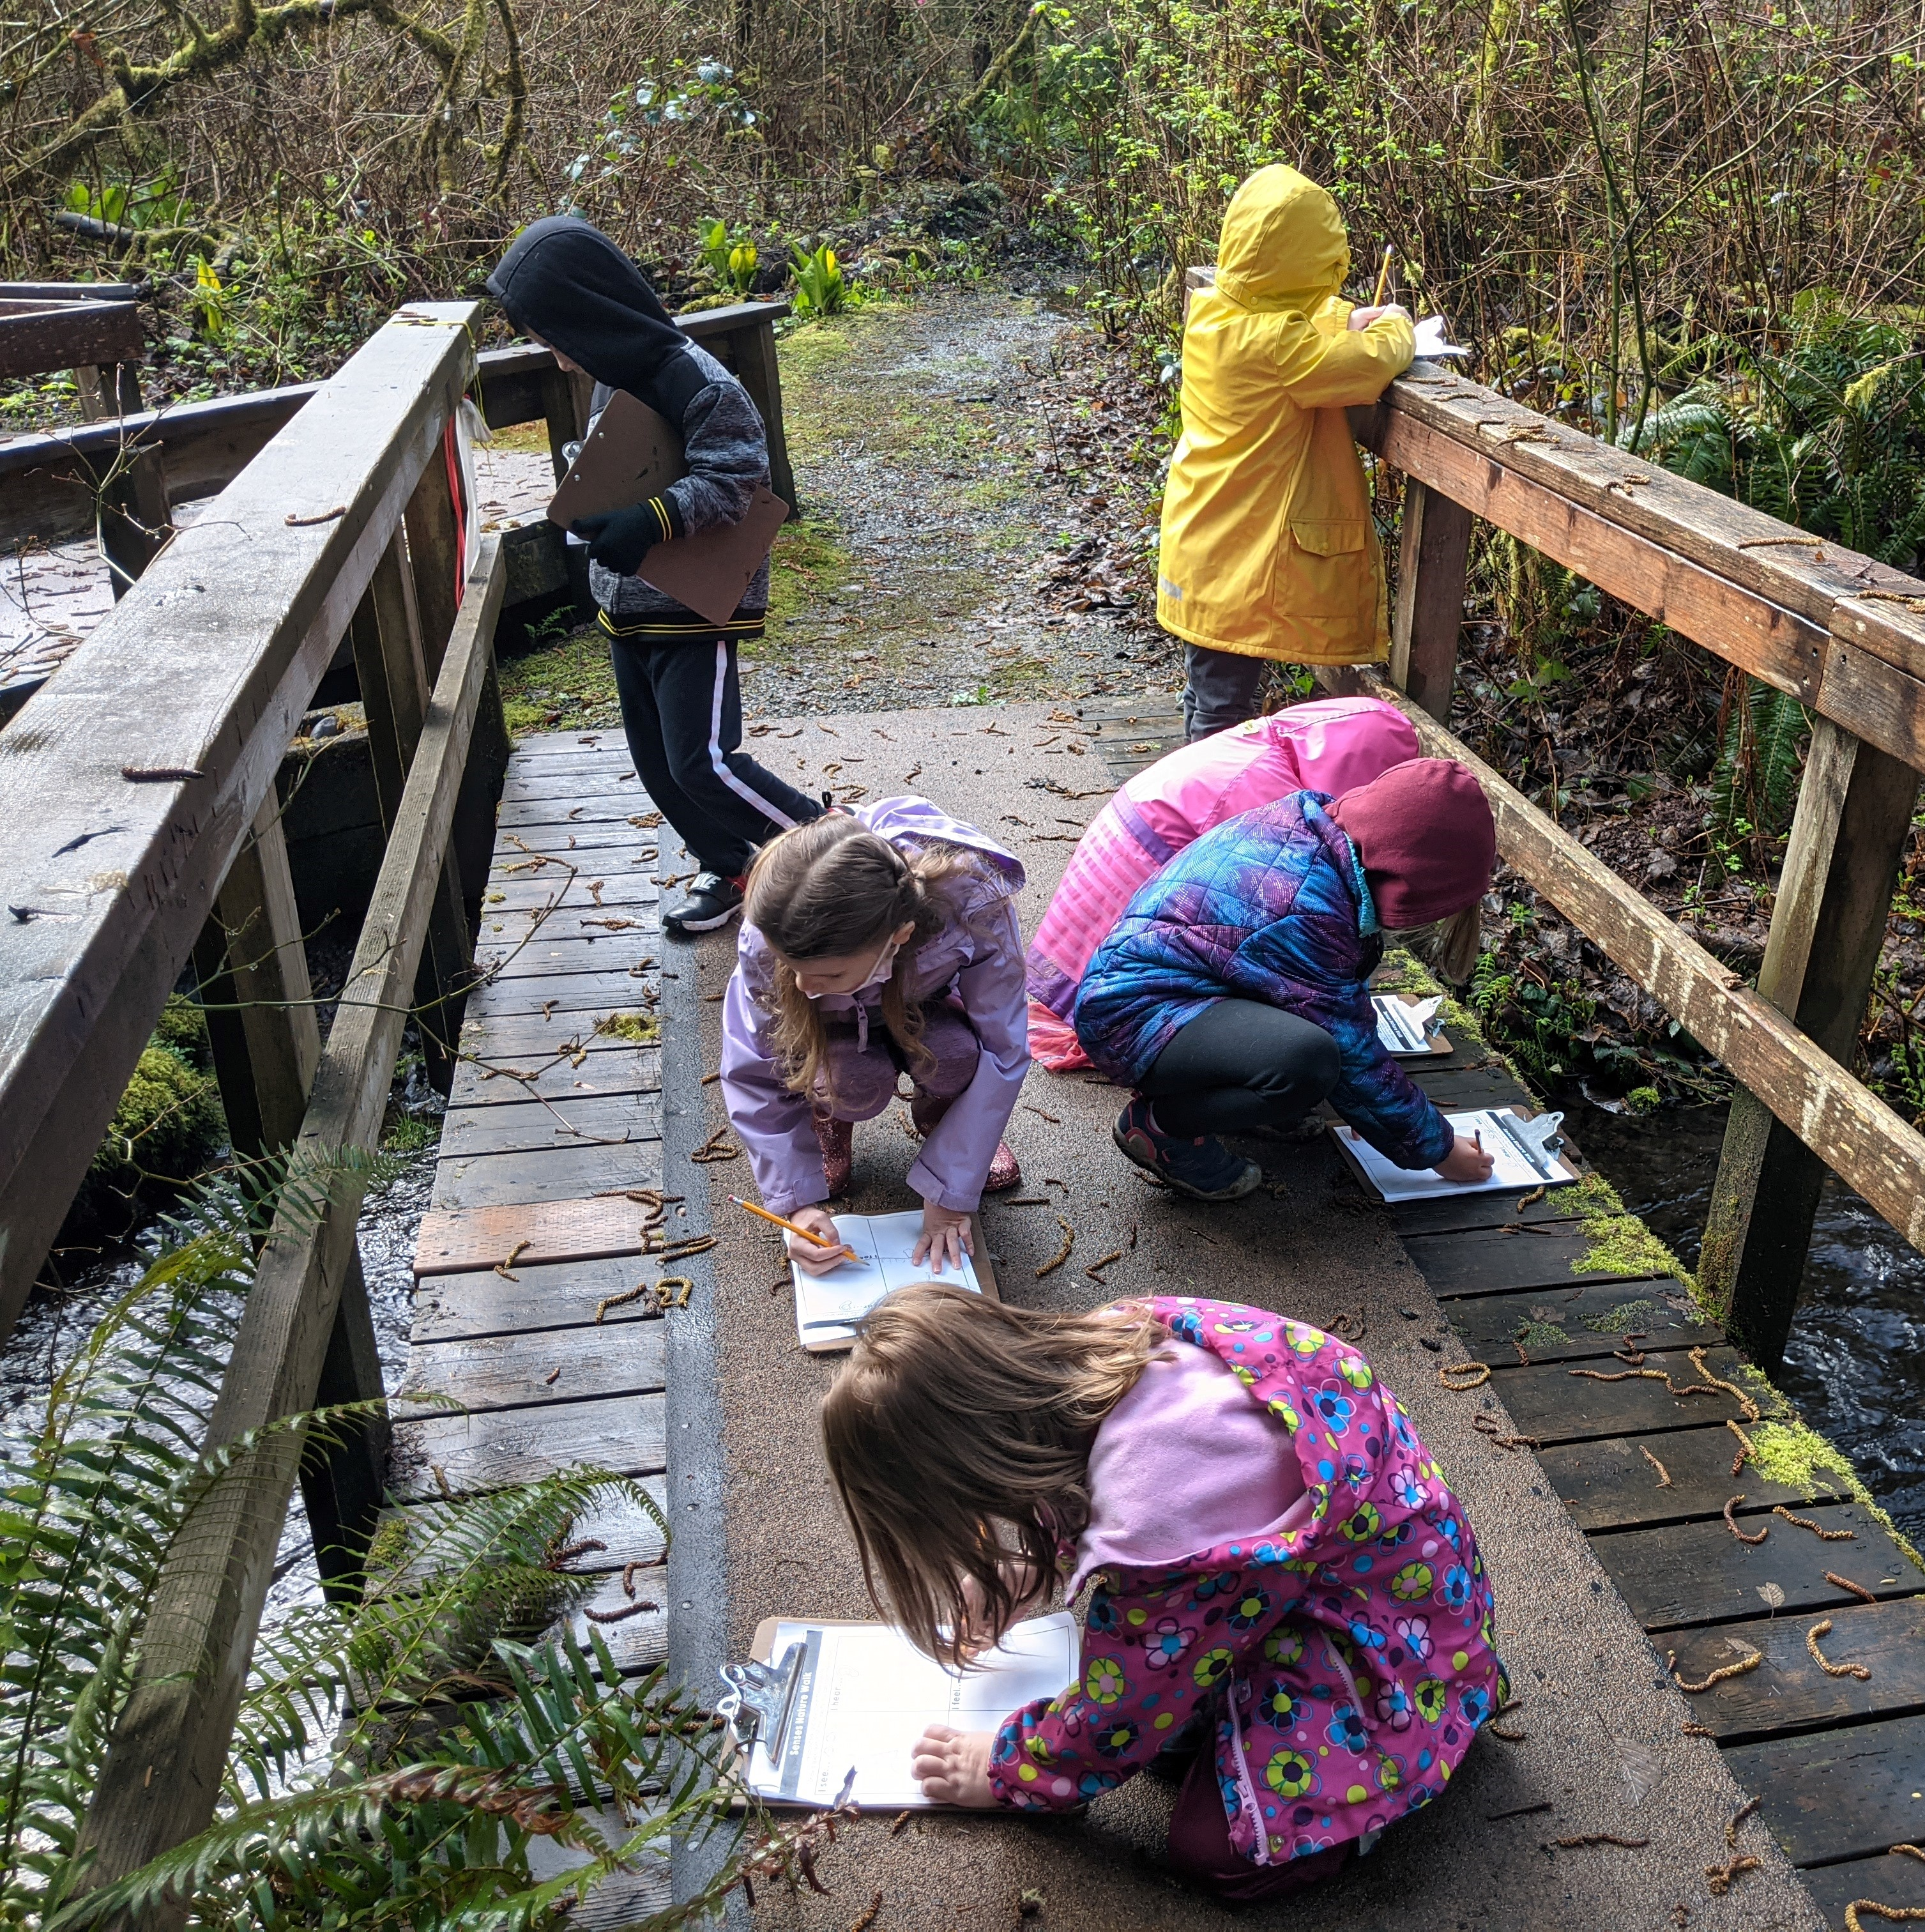
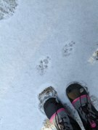
"Animals 2x2"
@ the Lively Environmental Center
Kindergarten-First Grade
Rain, snow or shine, the students observe nature and record their observations in their sketch journals and on their checklists

Slide 18
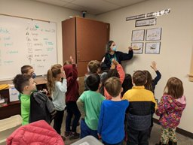
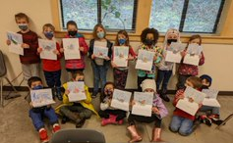
In the classroom, we continue our learning about animals by creating pop-up books with diagrams and sentences about the animals.
"Animals 2x2" ​
@ the Lively Environmental Center ​
Kindergarten-First Grade

